Slide 1
The Deeper Personalized Learning Transformation:
Building a 21C Learning
Ecosystem in Nevada
Embark on a Journey to the Future
CSAN Conference
September 22, 2017
Alber, Hinton, Regan, Kushner, Ahlawat
Notes:
Welcome to the Deeper Personalized Learning Transformation session. Thank you for joining us! To get a sense for who’s here, can you raise a hand if you are a charter school educator?
a principal or head of school? an administrator? another kind of educator? How many of you are involved with elementary school? middle school? high school? higher ed?

Slide 2
Session Objectives
Why does NV ed system need to TRANSFORM?
Why is DEEP Personalized Learning ESSENTIAL?
How do we shift successfully?
Panelists share strategies & insights
Q & A
Next Steps
Notes:
This Session has three main goals:
To explain why NV’s education system needs to be transformed
Describe why Deep Personalized learning is the essential strategy to do so
And invite you to participate in this DPL transition

Slide 3
Panelists to share PL experiences & advice
Jeff Hinton - Individualized Instruction @ A-TECH
Social Sciences teacher @ Advanced Technologies Academy Magnet high school and PLC leader, CCSD, NV Teacher of the Year 2014, 2 Heart of Education Awards, National Board of Professional Teaching Standards (NBPTS) Facilitator, Teacher Leader Academy Capstone Project Mentor, The Public Ed Foundation, Ed.D(c) Walden U.
Dr. Kimberly Regan - Personalized Learning @ SNACS
Executive Director & Founder, Sierra Nevada Academy Charter School & SNACS Preschool, first Pre-K to 8th charter in NV, Governor’s P-20 Council member, NevAEYC Past-President, entrepreneur: P.L.A.Y. Tech. in Ed., Educational Leadership, and ECE consultant: personalized, small school community, engaged, student-agency, and learning through choice.
Mark Kushner - National charter and innovation leader
CEO, Tahoe Expedition Academy and Impact Schools (www.impactschools.org) (preK-12 independent schools). Former CEO and developer of charters schools across US; founding CA state charter commissioner; Charter & education innovation Instructor at Stanford Grad. School of Ed. and Grad. School of Business. J.D., Ed.M.
Dr. Mary Alber - Moderator
Co-founder Education Innovation Collaborative, XQ Super School grant lead writer (semi-finalist), PhD transformative learning & change, MBA, information, technology & organization strategy consulting.
Notes:
I’m Mary Alber, in the process of co-founding the Education Innovation Collaborative as a non-profit to facilitate and catalyze education innovation in Nevada. An EIC colleague is also here - Priya Ahlawat - managing logistics today. Pat Hickey asked me to moderate this session because he advised our team in writing a XQ Super School grant application last year to create a next generation high school - which became a semi-finalist. While I’m not teacher by training, I’ve become a community organizer for 21st century education based on deep involvement in my two children’s experiences with private and public schools - both just sent off to college. To this challenge I bring a decade of strategy business consulting where I redesigned and managed change across multinational organizations through innovative use of information and technology systems. I went back for a PhD in human and organization transformative learning and change in order to better support the complex system change - of which our education system is clearly the most challenging and resistant to change that I have encountered. All the more fun!
After I speak to the first three points on our agenda, you’ll be treated to three amazing panelists who are leaders in designing an d implementing personalized learning in different contexts. Jeff Hinton is the 2014 NV Teacher of the Year with many other awards and roles beyond his official job: teaching for 16 years at the top ranking A-TECH Academy HS in CC. Jeff is pursuing his doctorate in education now, and will share some of the individualized learning strategies he has developed to engage his honors social science students.
Kim Regan and her teachers at Sierra Nevada Academy Charter School (north of Reno) were honored Thursday night for their 20th year in operation the first charter established in Nevada. Kim is the founder, and Executive Director of SNACS along with many other roles including ! She will share her original student-centered learning program for pre K to 8th grade - for which they have plans to expand into a high school next year.
Mark K
------
Past-Pres Nevada Association for the Education of Young Children
Governing Board Candidate National Association for the Education of Young Children
Owner PLAY® Technologies in Education
PLAY: Promoting Learning and Accountability with Young Children ®
Mark….

Slide 4
Why does NV’s ed system need to transform?
To realize Governor Sandoval’s GRAND GOALS
“Become the fastest improving education system in the nation”
Rise from BOTTOM of national ranking
Ed Week Quality Counts Report Card 2017*
Rapidly
IMPROVE
“EVERY student, IN EVERY classroom,
has EVERY opportunity to succeed”**
“50% of adults earning post-HS credentials”
from 30% currently with
18% of grads deemed ‘ready’ per ACT
Universal
SUCCESS
INNOVATE
“BE A GLOBAL LEADER IN INNOVATION”**
* Education Week Quality Counts 2017 **State of the State Address February 2017
*** Governor’s Conference August 2017 (updated SOS stated goal of 60% by 2025)
Notes:
While some believe these goals are unachieveable (“Sunny Sandoval” being too optimistic) - especially given the LACK OF FUNDING for ed in NV,
we believe they ARE possible - but ONLY with an innovative transformation of the system through collaboration among leaders like YOU.

Slide 5
To achieve goals, NV must OUT-INNOVATE others
Vision: 100% of HS grads prepared to THRIVE
Today: 18% of HS grads prepared to ‘succeed’
Transformative system changes unleash students to be
NETWORKED
21C LEARNERS
Patchwork improvements to outdated FACTORY system
Source: A Transformational Vision for Education in the US, Education Reimagined, initiative of Convergence Center for Policy Resolution
Notes:
When resources are lacking and ambitious are high, we must make a QUANTUM shift beyond current form - to literally go beyond form: TRANS-FORM.
To keep using band-aids to a defunct system is wasteful and futile.

Slide 6
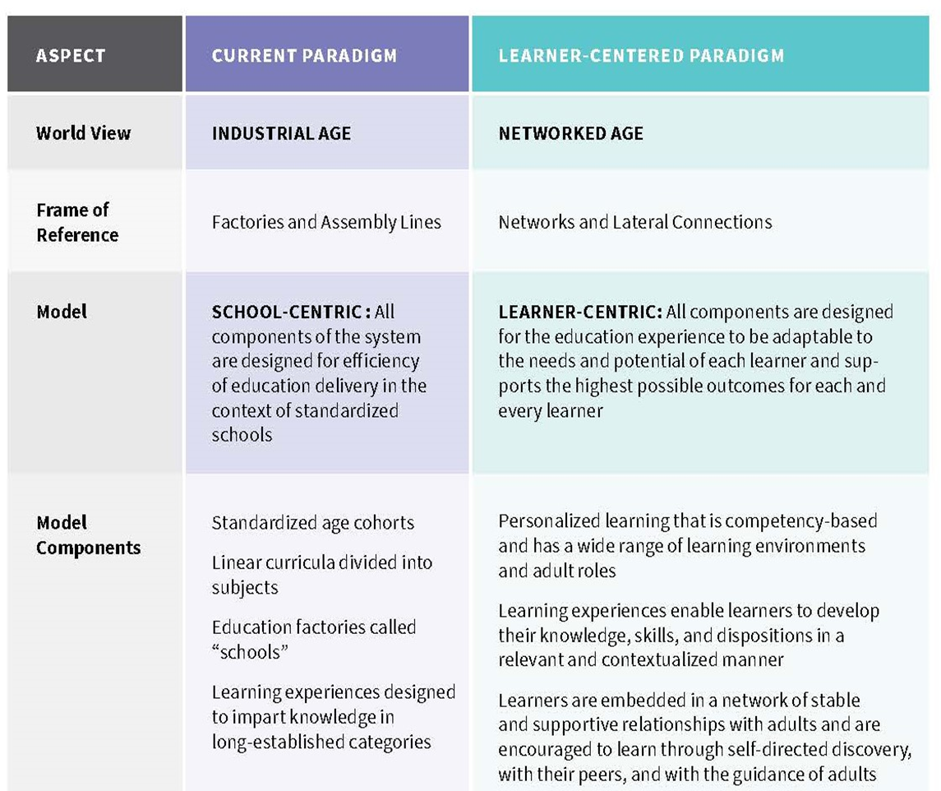
For this, we need a learner-centered paradigm shift
A Transformational Vision for Education in the US (click links)
by Education Reimagined, an initiative of Convergence Center for Policy Resolution

Slide 7
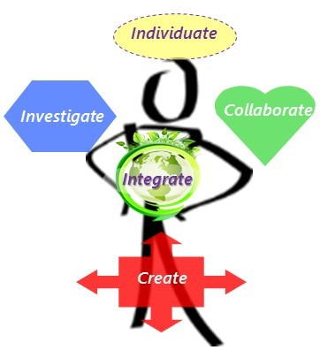
To THRIVE = UNLEASH curiosity, passion, POWER
“Who am I?
What are my gifts?
What do I love to do?”
“What am I curious about?”
“How can we work together better?”
“How do I understand the world?”
“How do I/we make the world a better place?”
Autonomy + Meaning + Feedback + Play = Creativity, Learning, Growth*
Source: XQ SuperSchool Washoe Design Phase application *Daniel Pink, M. Ciksentmihaly, Psychology of Creativity & Flow
Notes:
The science of learning - including psychological studies of CREATIVITY and PEAK achievement in sports, business, and education - has revealed a FLOW STATE of optimal learning and change conducive to INNOVATION and ENGAGEMENT for deep learning.
When students learn at the very CUSP of their individual APTITUDE and INTEREST, we eliminate the wasted time of students who are BORED and unnecessary stress of those who are OVERWHELMED by the pace and methods of teacher-led instruction that caters to a mythical average. There is NO AVERAGE student. All are unique!

Slide 8
HOW do we shift to Student-Powered learning?
Lead school pilots integrate best practice strategies
PERSONALIZED Learning Plans;
when, where, what, how
COMPETENCY
progression
to mastery, to plan
COMMUNITY engaged
student advocate teams, networks
EXPERIENTIAL Inquiries
deep PBL
TECHNOLOGY-enabled
fully integrated, robust, universal
Sources: EIC team, XQ Super School grant proposal, XQ Organization, Deeper Learning Network; Alliance for Excellent Education
Notes:
How do we embark on this essential challenge to transform the system - and do it gracefully? Our proposal: support current leaders and innovators as pilots sites to implement the best demonstrated practice strategies - together. With a focus on supporting Deep Personalized learning that honors student choice and voice in planning and engaging in their learning to their highest potential. To do this well will require competency and mastery-based progression, experiential projects with community engagement, and a high quality technology infrastructure and resources to facilitate implementation of all of these strategies most efficiently and effectively.

Slide 9
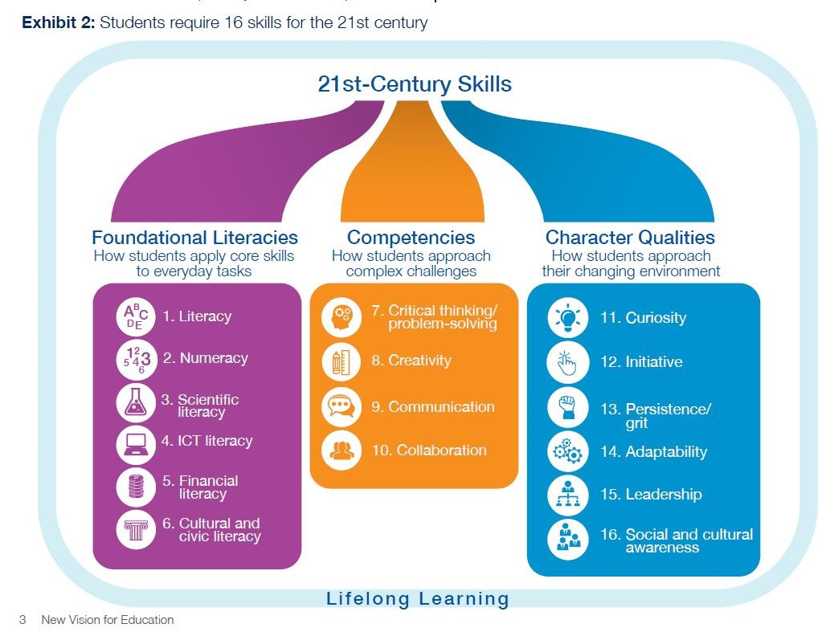
Pivotal need: Assess ALL 21C skills to ‘succeed’
Competencies well beyond ACT measures - to “Self-preneur*”
World Economic Forum report; What are the 21st century skills every student needs? May 2016 * EIC term
Notes:
Regarding the expanding competency and skills that need to be mastered, this World Economic Forum report on the New Vision For Education graphic shows 16 skill areas: End of Course and ACT readiness benchmarks measure Foundational Literacies of English, math, & science but not 3 others: Information & Computing Technologies, Financial, and Cultural & Civic literacy. Nor do we have measures of the four core Competencies for approaching complex challenges; critical thinking, creativity, communication, collaboration. In the right hand column there are six Character Qualities that are not currently measured and key to success in a changing world; curiosity, initiatives, persistence, adaptability, leadership, social and cultural awareness. This last one, #16 some are calling Social Emotional Learning (SEL) is beginning to be a focus for development but more for classroom management purposes. We believe PL should develop and measure all these skills to graduate SELF-PRENEURS - fully self-driven, highly creative leaders with high integrity and clarity about their evolving role in a rapidly changing world.
Start-up company in NNV, ALCHEMY human resources cloud services - chief skill needed: INTEGRITY

Slide 10
Need: Community-engaged learning ecosystem
Teacher & school-led instruction replaced by
Student Advocate Networks
w/ Personalized Learning Plan & Coach Team of parents, counselors, teachers, mentors
who facilitate projects & apprenticeships
Amy Anderson, Director of ReSchool Colorado Donnell-Kay Foundation
Notes:
For all students to learn these greater breadth and depth of skill and knowledge, teachers, parents, and community members must participate and collaborate to help students build their capacities to navigate the complex learning ecosystem for themselves with growing confidence. Through Coach Teams and Student Advocate Networks, as they call them at ReSchool Colorado, community members help close opportunity gaps - and ensure equity - by expanding the learning opportunities for ALL students through virtual and in-person projects, apprenticeships, and mentorships; greatly expanding the number of young people who are skilled and connected Self-preneurs.
-------------
“...a collaboration with student’s family/guardian to navigate the learning ecosystem in service of his/her personalized goals through the coordination of experiences, resources, and people”. A cohesive learning framework includes schools, classrooms AND personalized, modernized, and diversified learning opportunities via a wide web of people & perspectives from local community & world.

Slide 11
KEY: Innovation leaders COLLABORATE to leverage strengths & increase success & impact.
Lead Innovator Pilot Sites
Charter Schools
NR21 Pilots
Career Tech & College Prep
Deep Personalized 21C Learning
CBE Pilots
Victory schools, Title I & IV funds, Special Ed IEP
ESSA
More info: CSAN, Nevada Ready 21 program, NV ESSA Plan, AB110 Competency-Based Education pilot network
Notes:
We are now looking for pilot site innovators who are interested in collaborating with others to leverage existing strengths and increase the chances for success and impact from implementing deeper personalized learning. We anticipate charter schools will be strong candidates who are leading the way with personalized approaches in classrooms, project-based learning, and deeper measures of competency - such as SNACS. Some Nevada Ready 21 program middle schools may be interested and ready to participate as they have the technology infrastructure with 1:1 devices for every students that is necessary for PL platforms. With the passing of the Competency-based Education program bill in June, we hope to include those school pilot sites into the deeper personalized learning network collaborative.

Slide 12
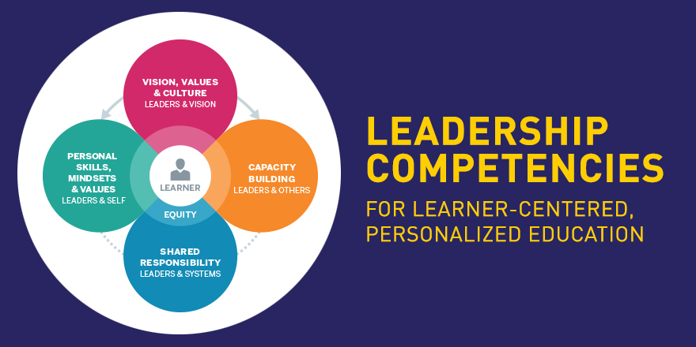
Pilot leaders & educators engage via PD Portal
Leadership Competencies for LCPE, Educator Competencies for LCPE
Source: Council of Chief State School Officers (CCSSO) & Jobs for the Future (JFF)
PARTICIPATE PD PORTAL
Notes:
A critical first step for DPL pilot network participants will be learning the skills to LEAD and EDUCATE in this new culture and environment. The Council of Chief State School Officers and Jobs for the Future have partnered to create resources and programs to support this learning process - as have many other organizations and state and federal education departments. See the links to resources in the Appendix of this presentation.
The Council of Chief State School Officers (CCSSO) and Jobs for the Future (JFF) have released Leadership Competencies for Learner-Centered, Personalized Education, a resource that serves as a first step in identifying the knowledge, skills, and dispositions leaders must master in order to build and sustain learner-centered, personalized schools and learning environments. Personalized learning
• Competency-based education
• Anytime/anywhere learning opportunities
• Student ownership

Slide 13
Pilot leads evaluate resources to support Deep PL
Summit’s Personalized Learning Platform is being piloted at 4 schools in CCSD, supported by Chan Zuckerberg Initiative:
“Advancing human potential and promoting equal opportunity”
Tipping point: Can Summit put personalized learning over the top?
Chris Berdik, HechingerReport.org, Jan 17, 2017
Summit Learning Intro Video
iNACOL Webinars: How Teachers are Leading Change for Personalized Learning, Strategies for Leaders Shifting to Personalized Learning
FUTURE READY LEADERS programs, US Office of Education Technology
See Appendix for more resources - see EIC Knowledge Hub in development
Notes:
From our research, we’ve found Summit to be a leader in designing a personalized learning platform - which they’ve shared with over 120 schools and teacher teams across the country. NV Superintendent Canavera has endorsed Summit program and is encouraging schools to become a pilot adopter of this program. PLP is a an open-source platform that is adaptable by every teacher to create “playlists” of projects and learning applications - existing or original - for students to draw from.
We have learned much from attending iNACOL, reading their research, and watching their webinars on many subjects related to 21st century learning.
We encourage schools and districts to participate in the Future Ready Leaders assessment program offered by the US Office of Ed Tech

Slide 14
Grow capacity and scale through gradual steps
Deeper Learning
School-wide
Grade level
Student Digital Portfolio
accrue competencies
store learning artifacts
replace A-F grades with competency types and levels for all subjects
eliminate bell schedule
Graduation pathways
not age-based ‘grades’
aligned to career goals
Student Advocate Teams
Community project sponsors, mentors
Classroom
PBL cross-subject, disciplines
access network of resources
Define 21C competency measures - mastery levels
Adopt Personalized Learning Plan platform
enable individualized goals; content, levels
more choice of when, where, with whom, how demonstrate
Project-based Learning PD
thematic, whole class
student choice topics, demo
competency expectations
group collaboration process
community engagement
Content applications use
flex student pacing
Notes:
When we begin to working with Pilot volunteers embarking on the transition to Deeper Personalized Learning environments, we’ll begin at the classroom level with PBL strategies aligned with content applications that support flexible student pacing through competency demonstration. Jeff Hinton will describe an example of this in just a moment.
The next step would be to implement these across all educators in a grade level - including cross-subject integration through projects and development of detailed competencies. When teams are ready, they could evaluate and adopt a Personalized Learning Plan platform for the grade that could be expanded for use by other educators in grades above and below.
After that phase, the program could be implemented across a school and with schools above and below the initiating school. With the pipeline of grades from K-12, a Digital Portfolio system can be adopted or developed from the PLP and the full features of deeper learning can be implemented - including new pathways, advocate teams, and community member engagement. Kim Regan will share a glimpse into the SNACS integrated program P-8.

Slide 15
Want to LEAD the way to NV’s
Deeper Personalized Learning EcoSystem?
Join EIC’s
DPL Collaborative Learning Community
Contact the Education Innovation Collaborative @ EIC-NV.org to help catalyze a world-class Learning EcoSystem for the New Nevada.
Notes:
Does this sound like an exciting opportunity ? Would you like to be a recognized innovation leader who helps to catalyze a Deeper Personalized Learning Ecosystem for the New NV? If you have questions and/or want to discuss this opportunity with me, Priya, and panelists, please fill out the paper that was Priya gave you when you entered.
And now I have the honor of introducing Jeff Hinton to share his experience with Individualized Instruction as a Social Studies teacher at A-TECH High School .
-------------------
EIC is here to nurture and empower the amazing teachers and school leaders like you are the only ones who can lead our public schools into the future. We bow in honor and deep respect you!

Slide 16
Individualized Instruction
The National History Day Program & Flipped Classroom
Jeff Hinton

Slide 17
Why Change?

Slide 18
From a principal’s publication in 1815:
“Students today depend on paper too much. They don’t know how to write on a slate without getting chalk dust all over themselves. They can’t clean a slate properly . What will they do when they run out of paper?”

Slide 19
From the journal of the National Association of Teachers , 1907:
“Students today depend too much upon ink. They don’t know how to use a pen knife to sharpen a pencil. Pen and ink will never replace the pencil.”

Slide 20
From the science fair judge in Apple Classroom of Tomorrow chronicles, 1988:
“Computers give students an unfair advantage. Therefore, students who used computers to analyze data or create displays will be eliminated from the science fair.”

Slide 21
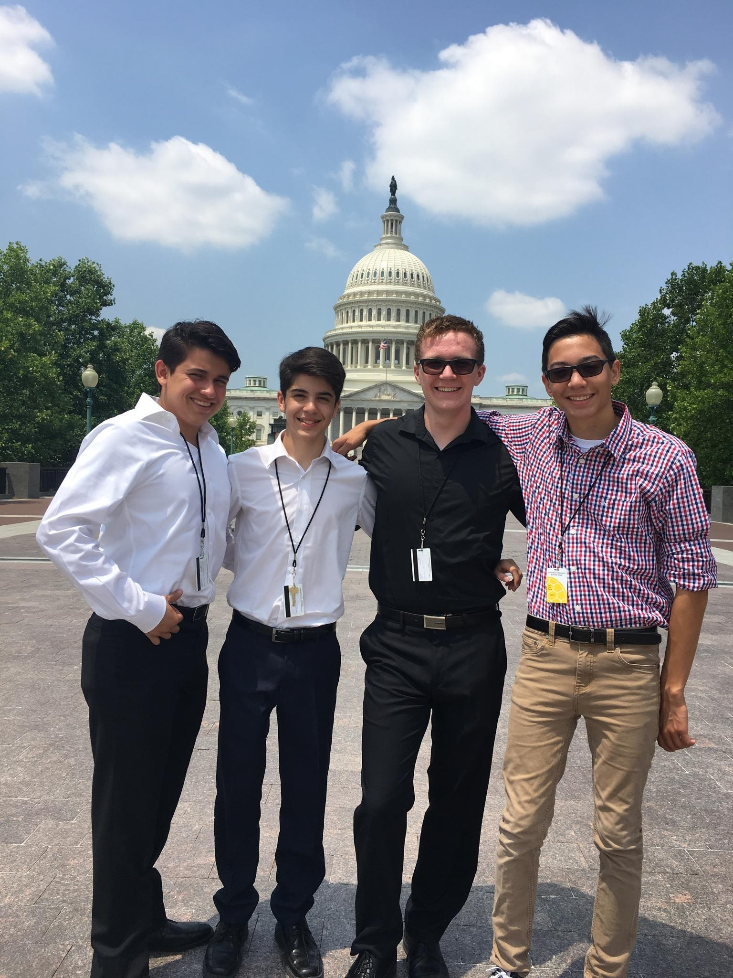
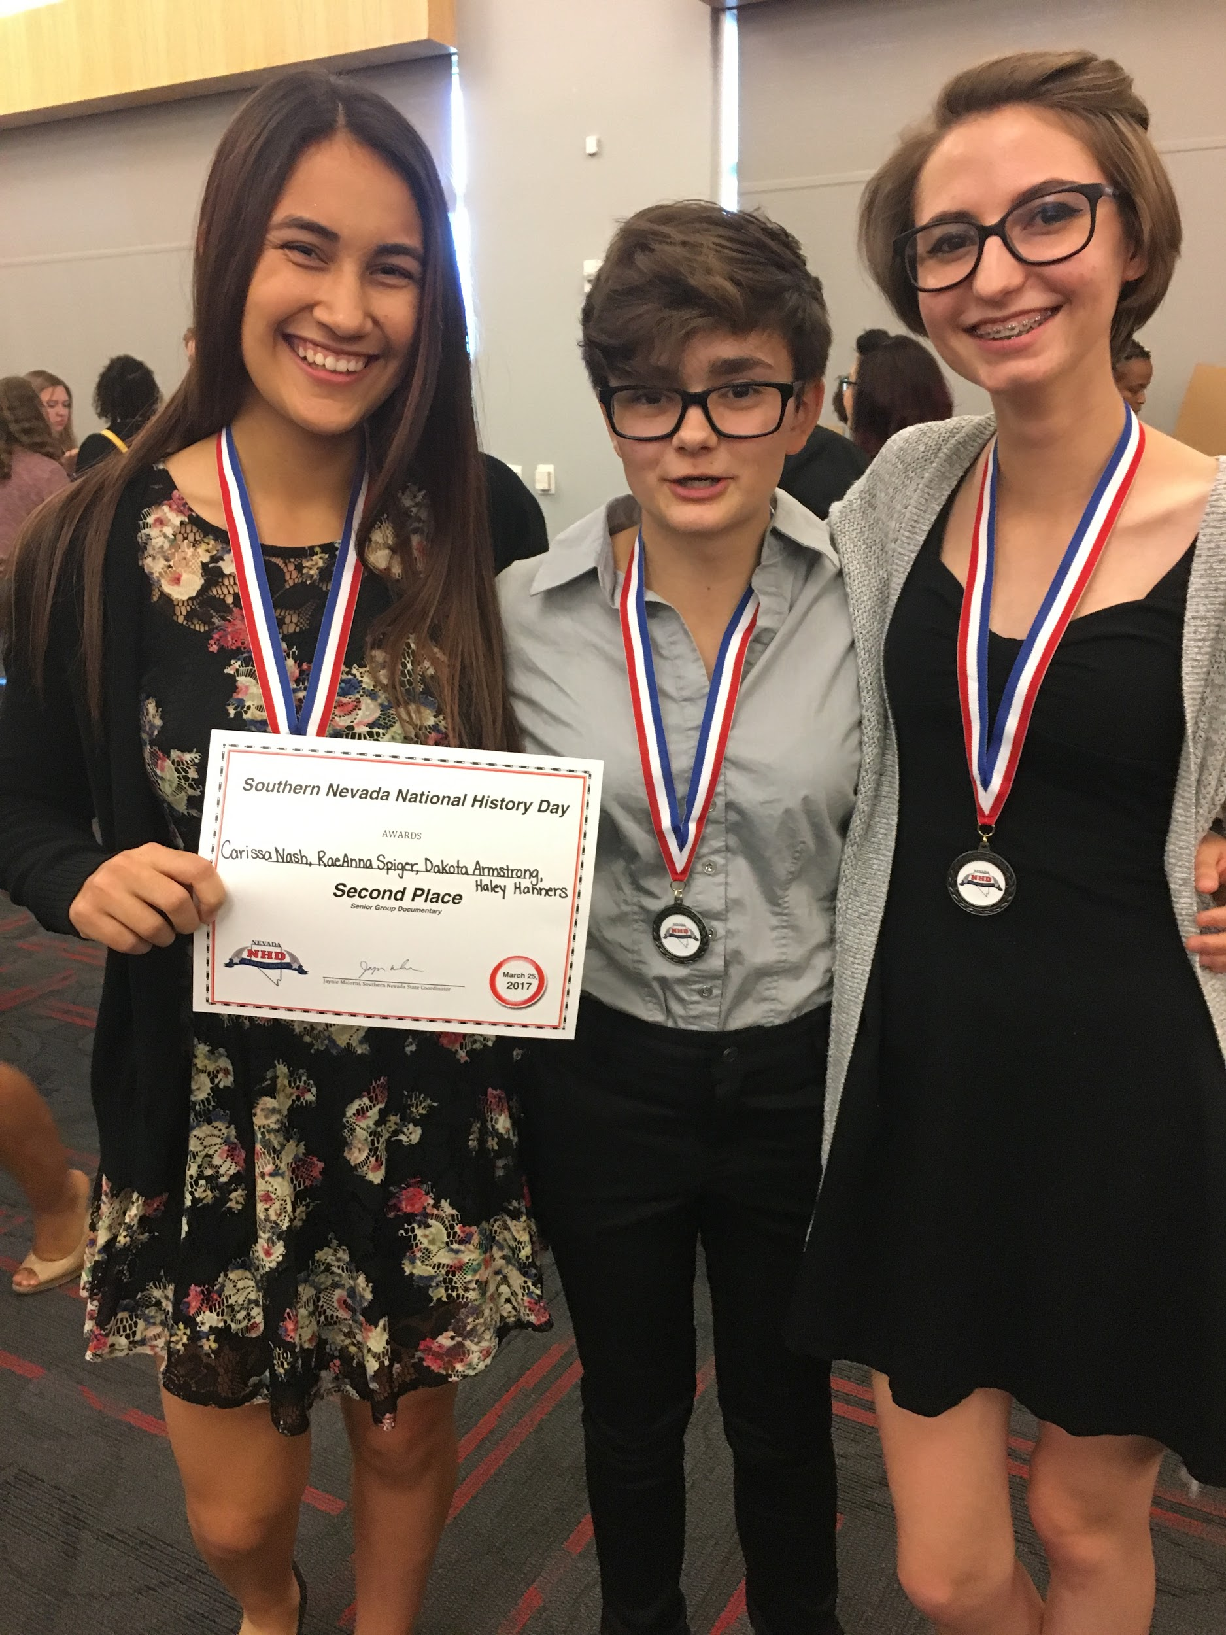
What is NHD?
A history based academic competition in which students working individually or in groups conduct primary and secondary research on a historical topic of their choice. Topic must address NHD’s annual theme.
They then communicate their research in one of several presentation categories to include the exhibit board, documentary video, research paper, website and historical performance.

Slide 22
NVs 2017 Senior Division Group Documentary
Atari: The Revolution

Slide 23
Other Project Based Learning Units I’ve Created
Voices of Our Veterans Oral History Project
Voices of Vegas Oral History Project
NV 150: Nevada Past, Present & Future
Nevada Museum
A Conversation with Lincoln (My 1st PBL, I didn’t even know what PBL was!)

Slide 24
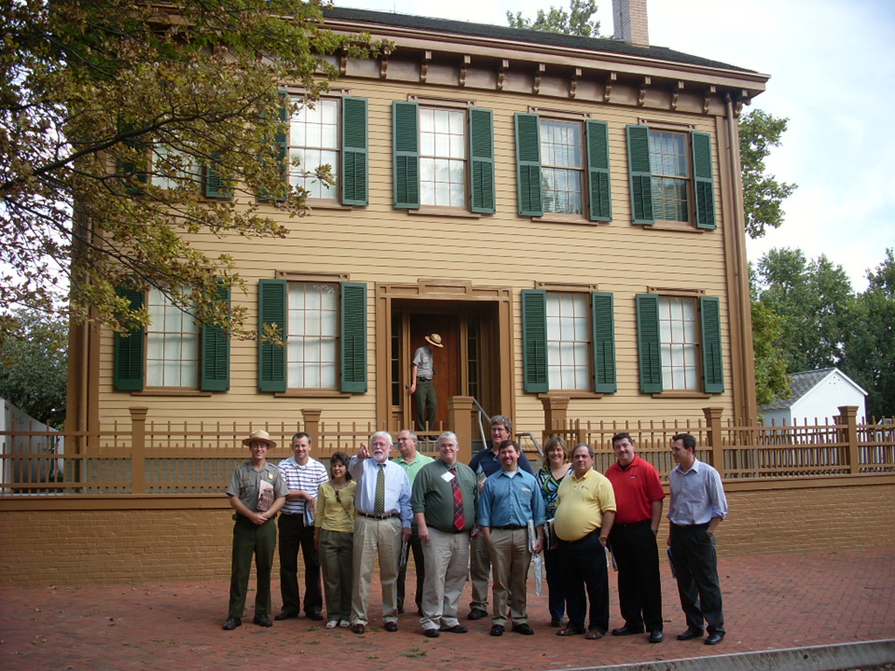

Slide 25
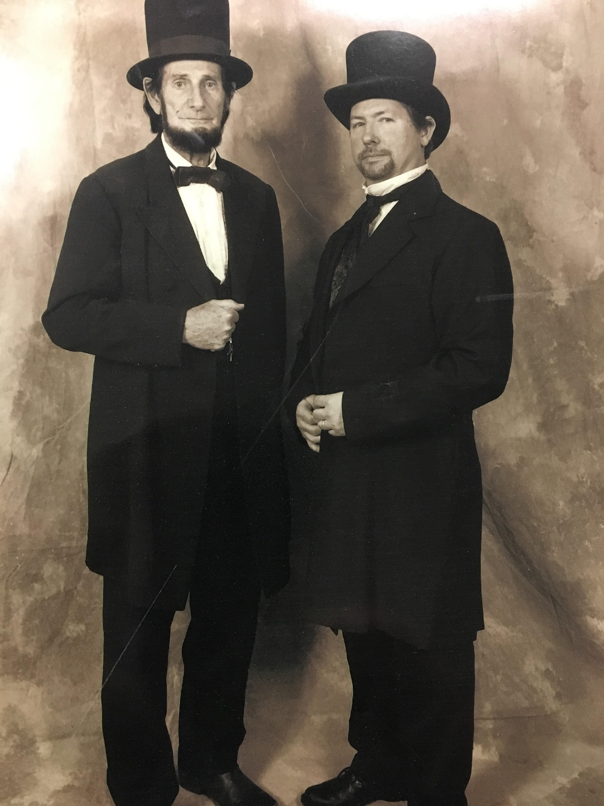

Slide 26
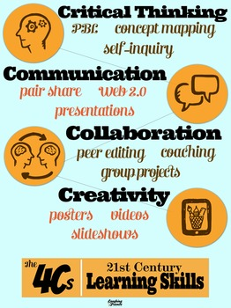
21st Century Learning for a 21C Economy
When planning lessons and activities I am always thinking about the 4Cs

Slide 27
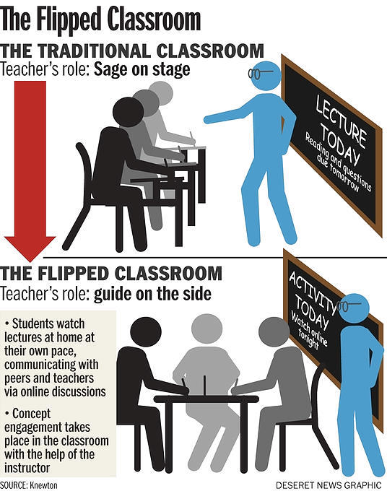
Flipped Classroom
The flipped classroom is a pedagogical model in which the typical lecture and homework elements of a course are reversed.
Short video lectures are viewed by students at home before the class session, while in-class time is devoted to exercises, projects, or discussions.

Slide 28
Benefits of a Flipped Classroom
Teachers get more one on one time with their students.
Students learn at their own pace
– The ability to pause, rewind and rewatch videos allows students more time to learn about concepts they find challenging.
Encourage & Empowers Mastery Learning
Address Absenteeism.

Slide 29
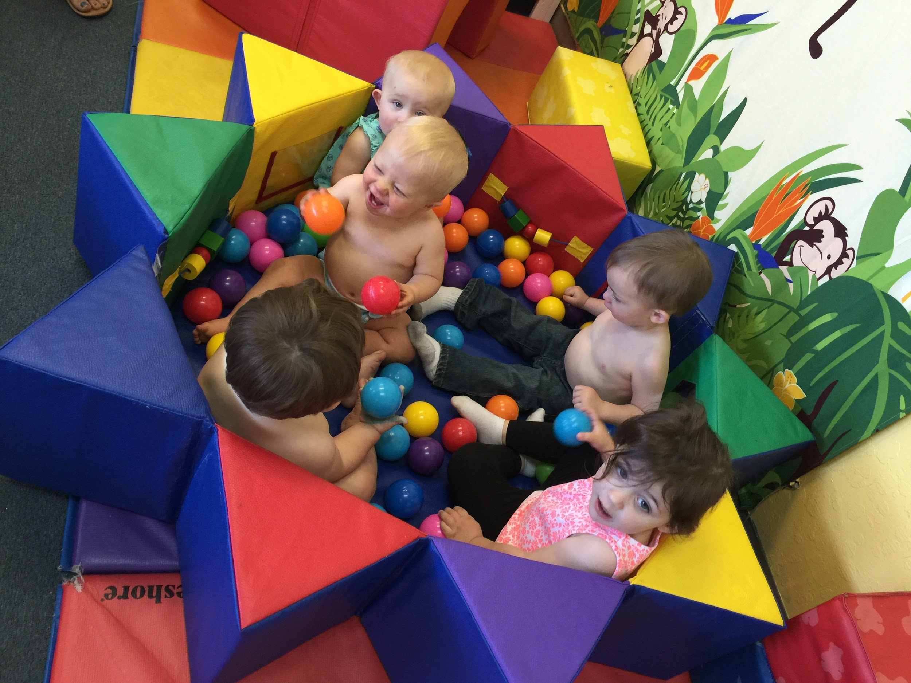
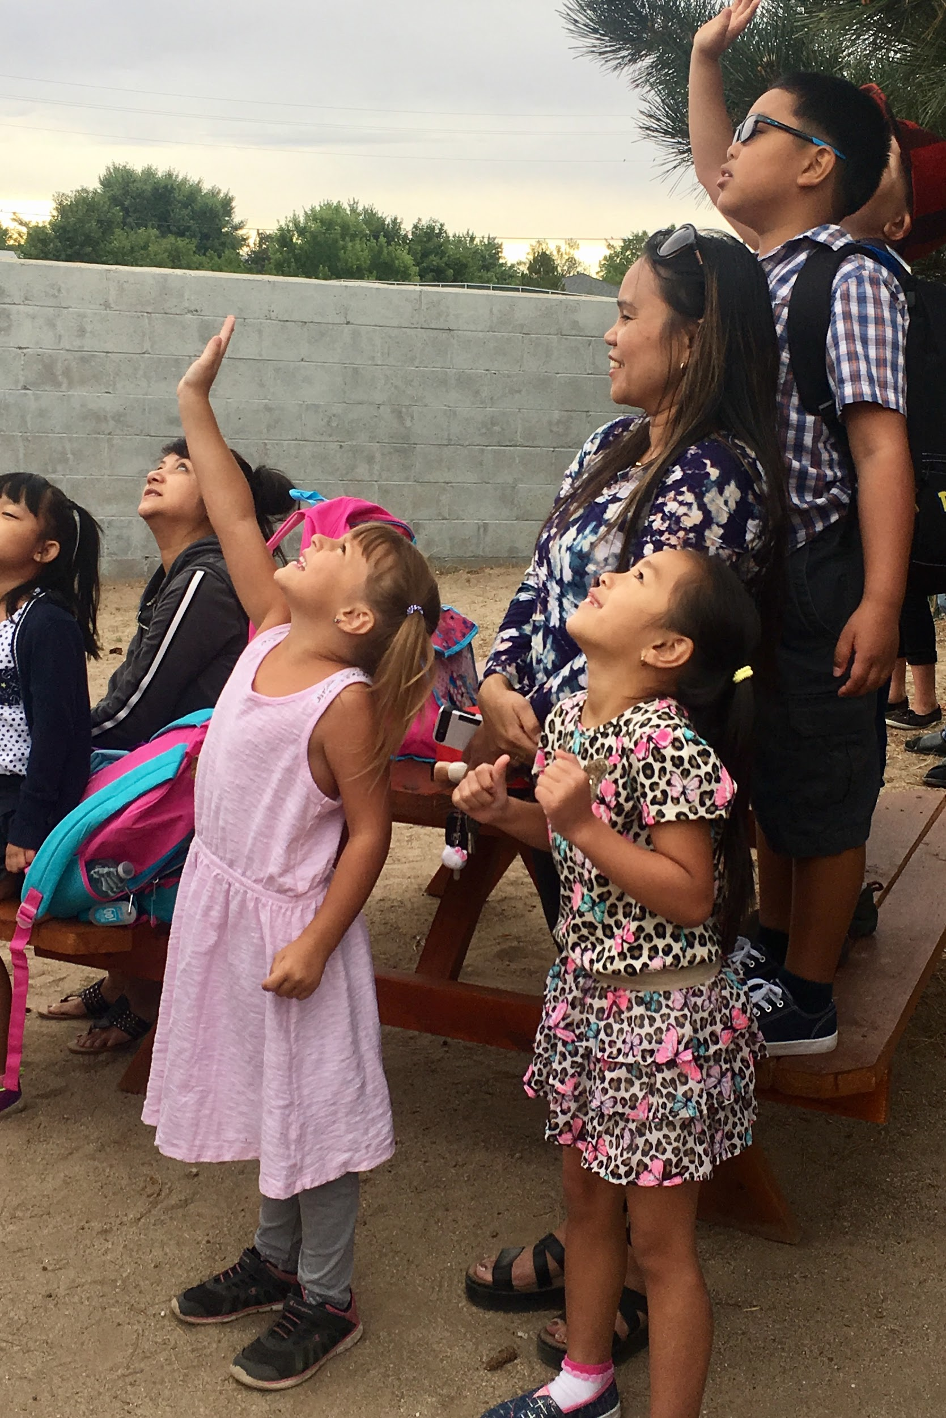
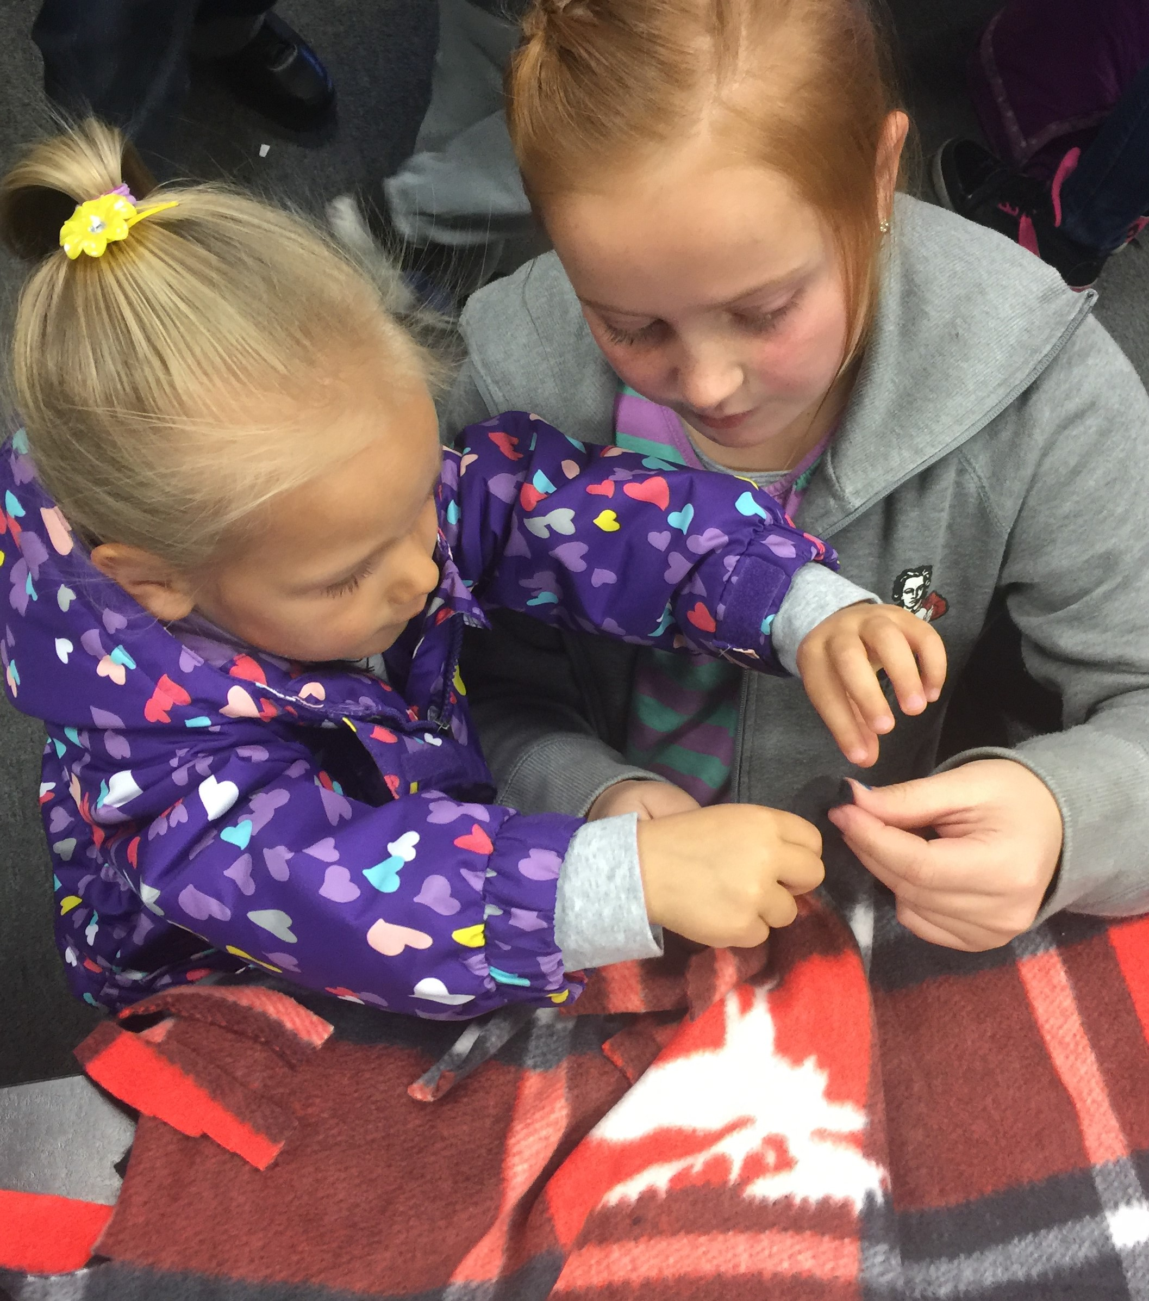
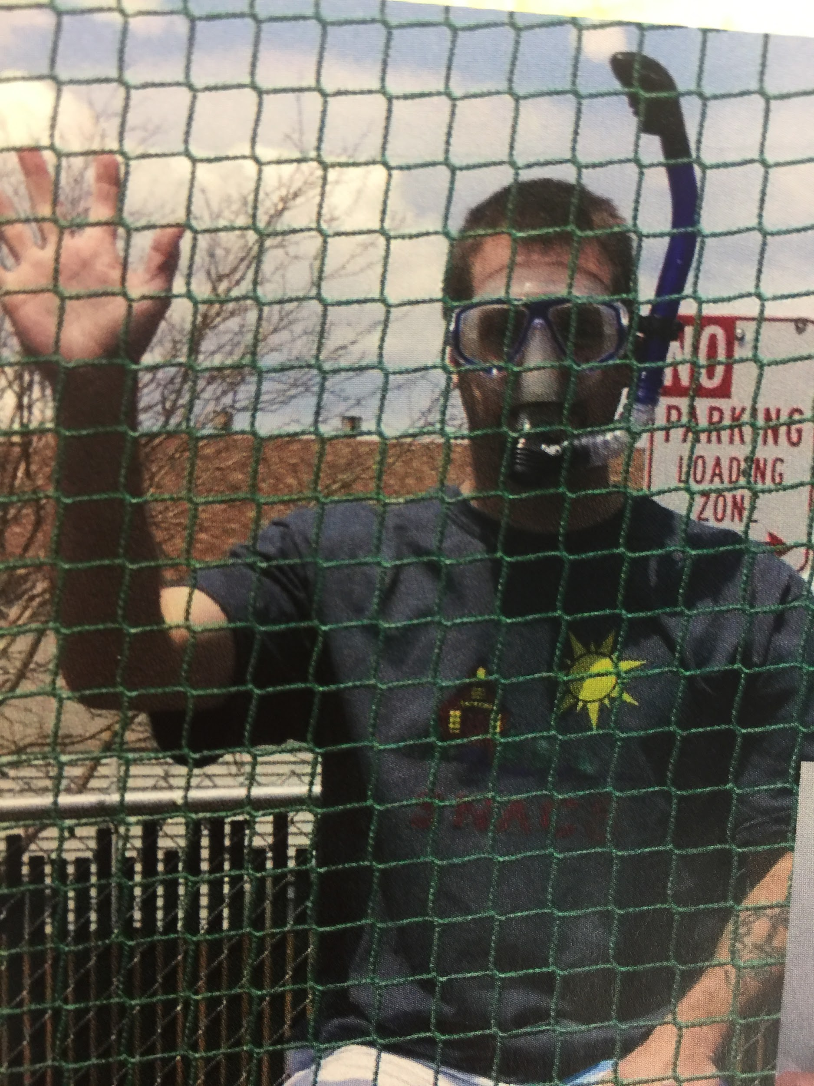
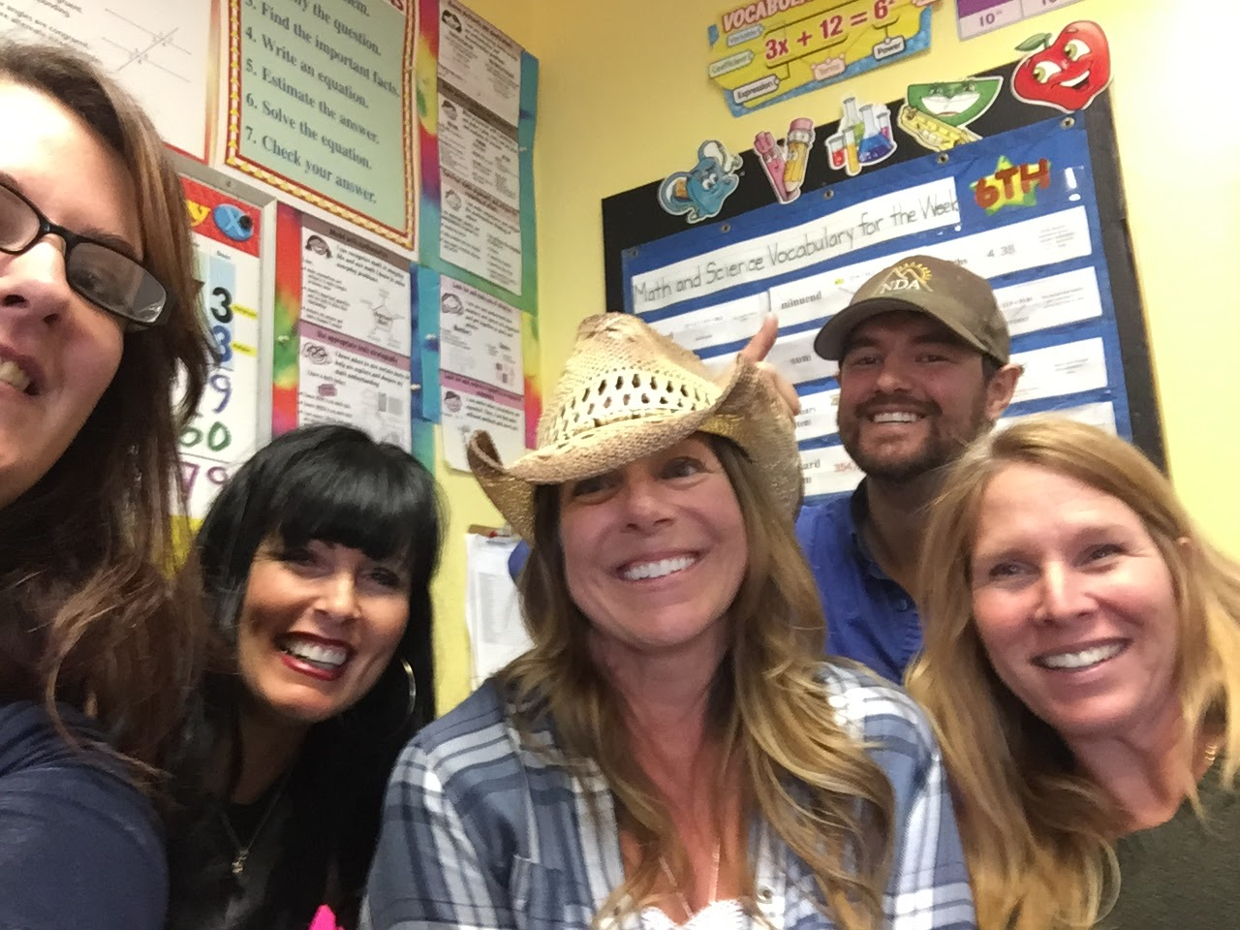
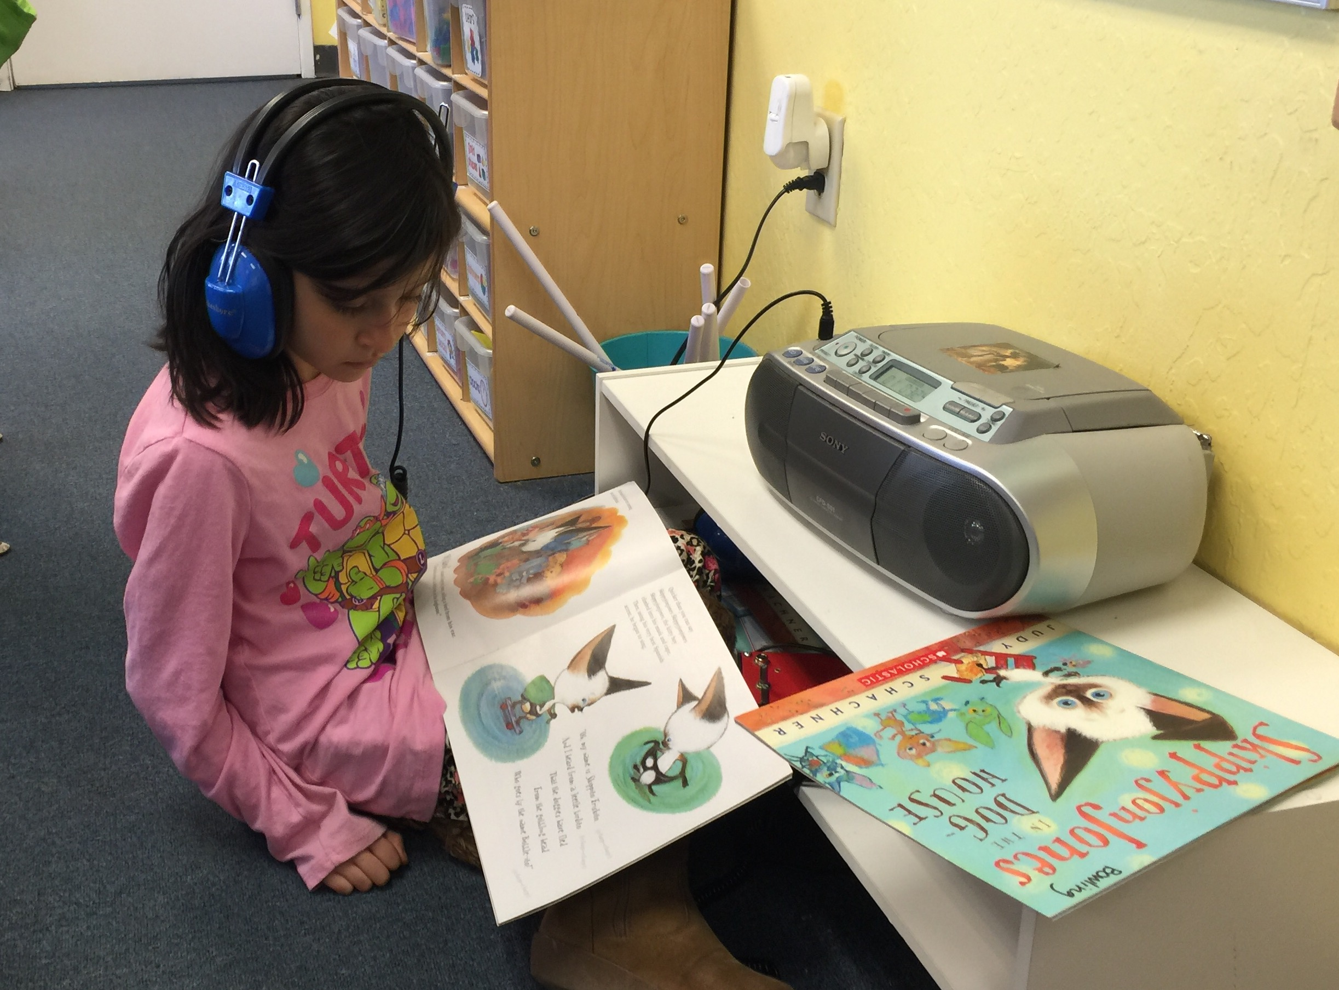
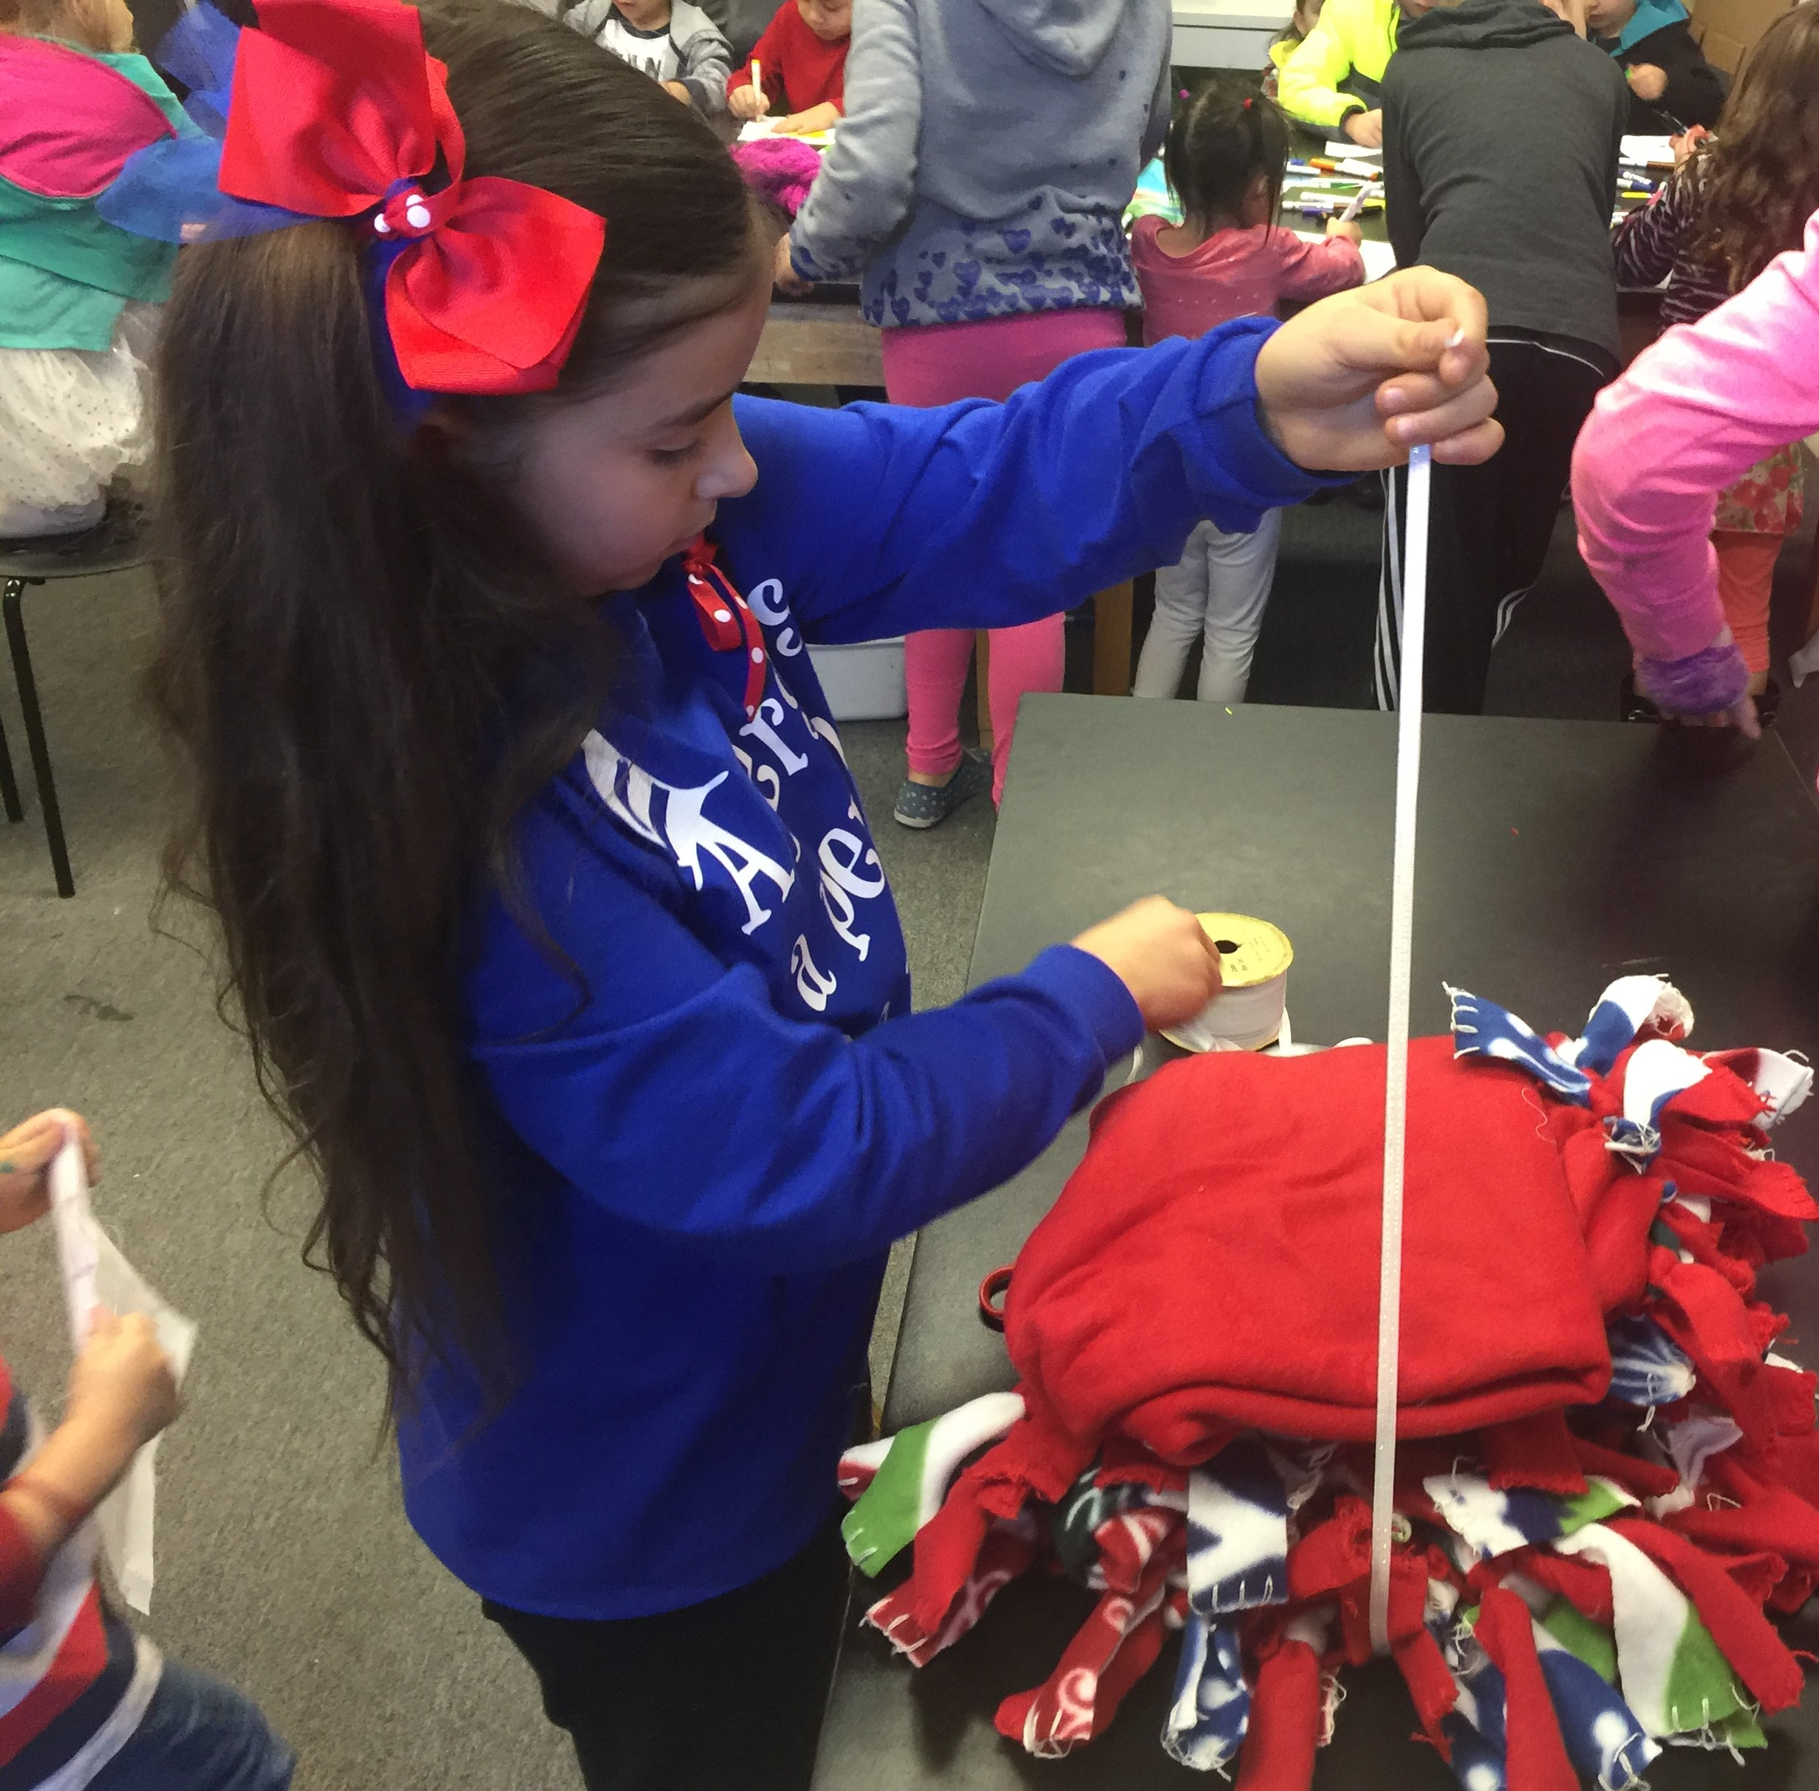
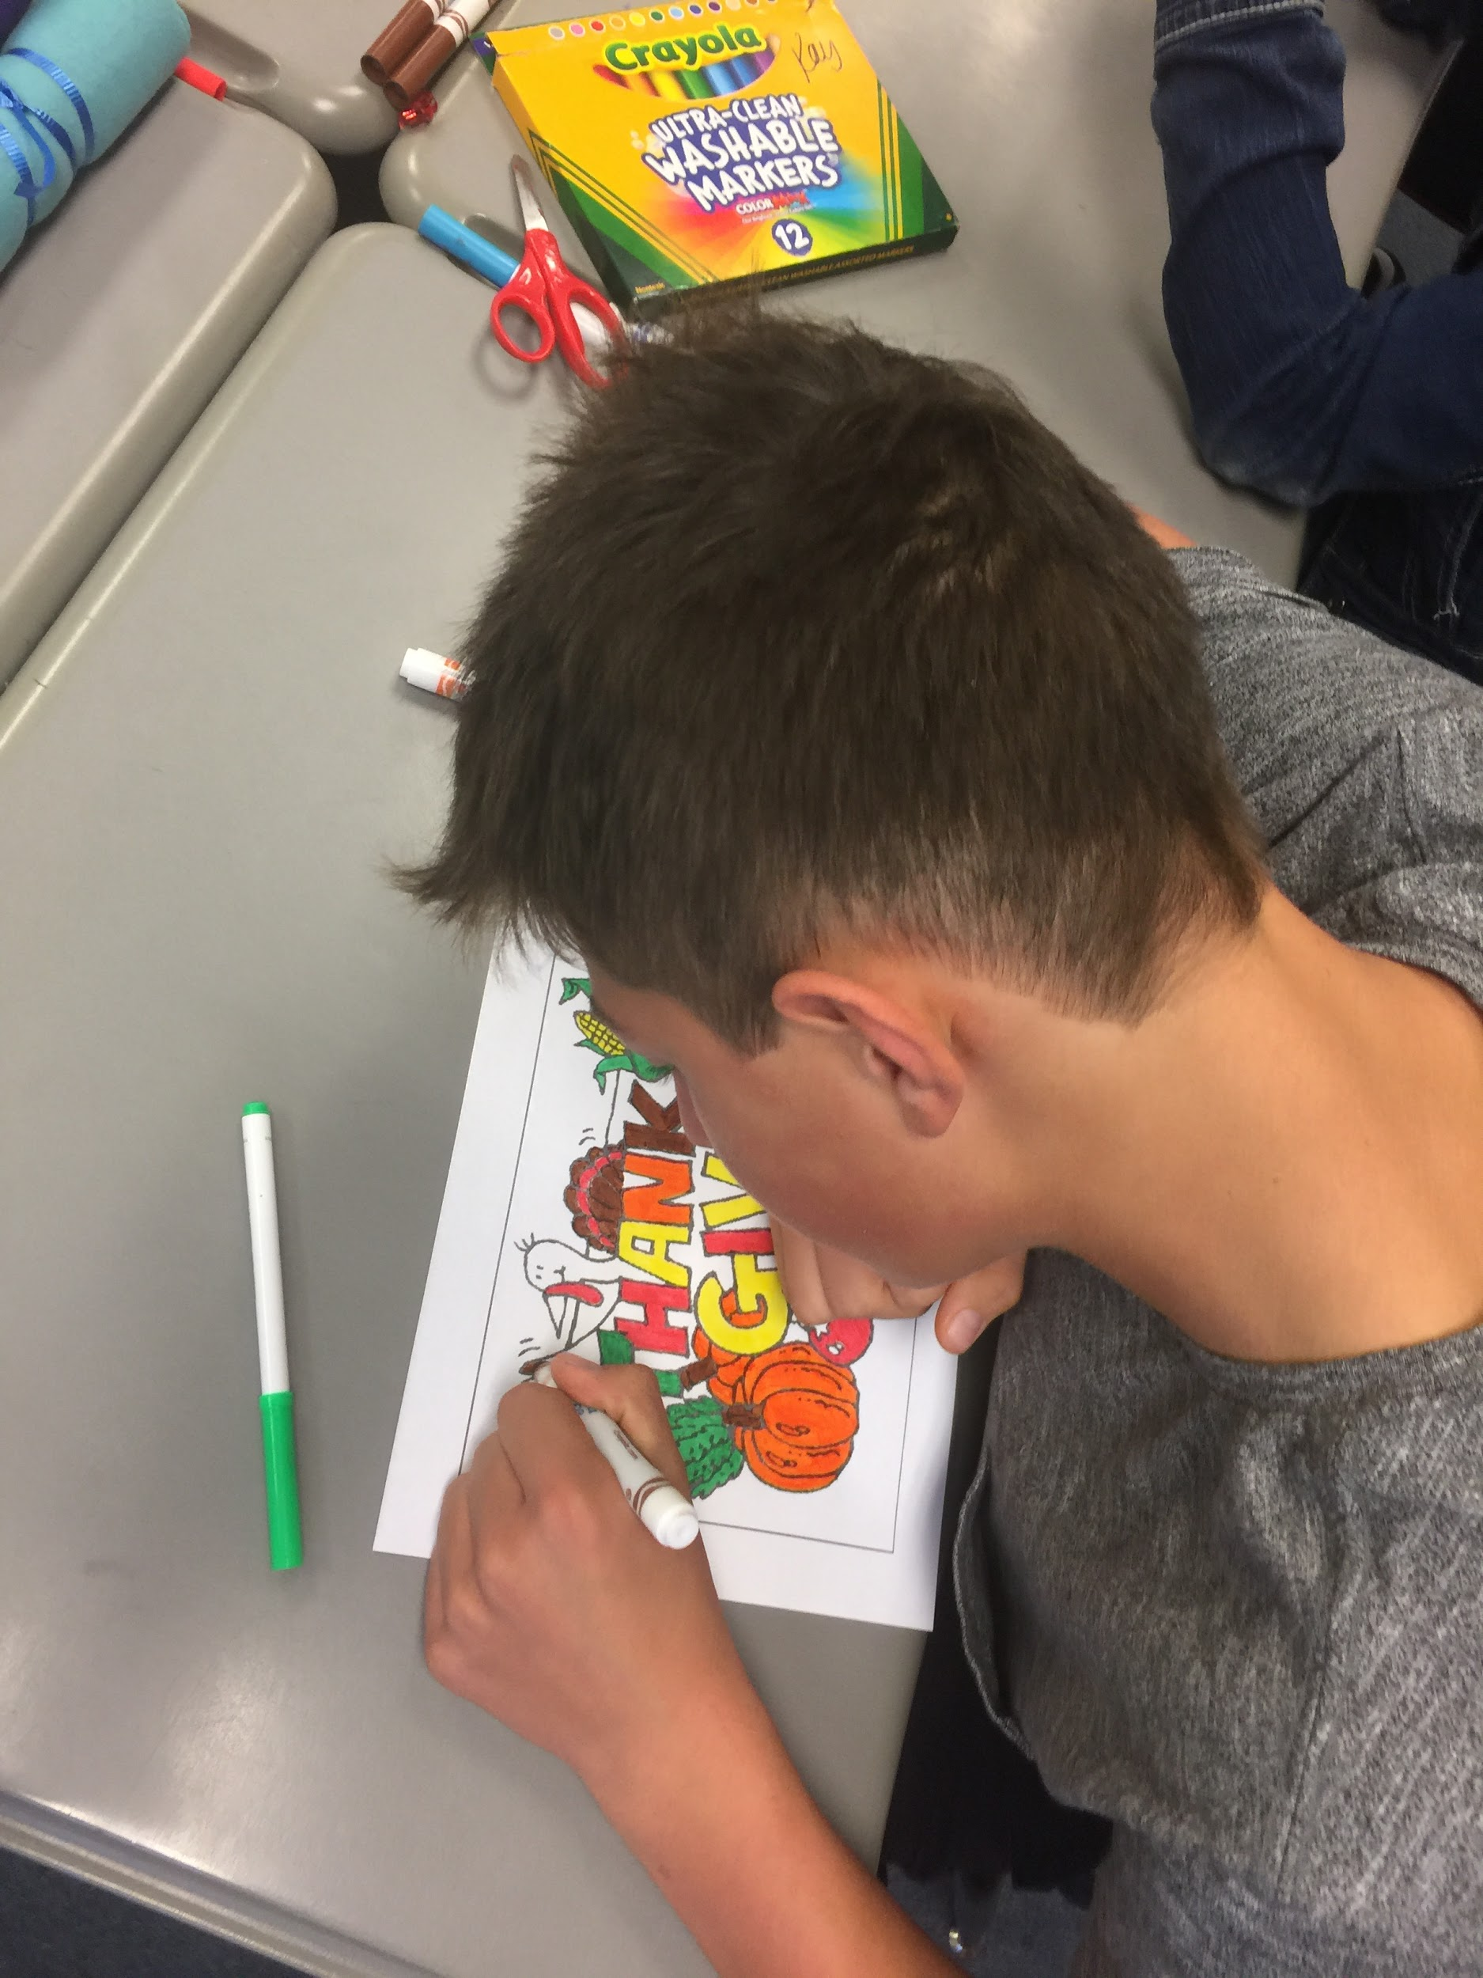
SNACS Deeper Personalized Learning
SNACS video

Slide 30
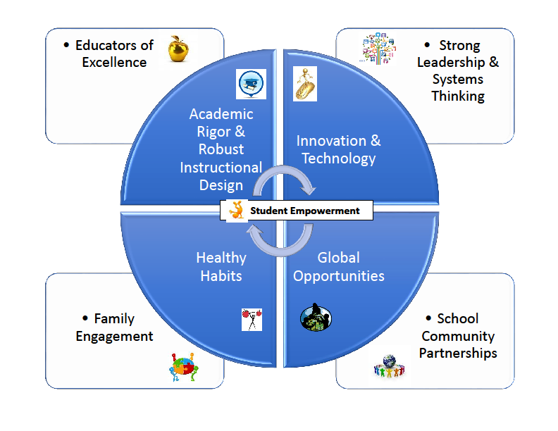
The SNACS Model
Notes:
The video portrays student empowerment and the academic rigor & robust instructional design: empowering students via personalized learning - PLPs, ability groups, choice, intentional environmental design, embedded formative and summative assessments.
SNACS Personalizes Learning leveraging technology - multiple types of devices and differentiated activities via (online curriculum texts, videos, and games. We are also working on systemic infrastructure to support the model.
Healthy habits: physical, social-emotional, and cognitive healthy habits. SNACK as a choice - fresh fruit and vegatables program.
Global opportunities - ELOB and Living history days older students are the leaders for the younger students, run the student government, store, and participate in civic leadership - including testifying at the legislature on charter and/or education issues - Washington, DC trip to visit Capitol and Congress.
Educators - Personalized PD - developed our own teacher training - vett our teachers intensely and then the induction process is intense. Tchrs - mentor new teachers based on expertise, peer coaching, video critiques, and apply for NDE credit based on learning new content that is SNACS related - latest example - guided reading in small groups during center time.
Strong leadership and systems thinking - trained in systems thinking and entrepreneurial leadership, lifecycle of a business - always thinking 3-5 years out on multiple
Family Engagement - Personalized family engagement - 10 hrs per month tailored to the their unique interests and talents - DJ, catering, construction, classroom, etc.
School community partnerships - Angel tree partnership, wrap-around services, ELOBs Authors day, Farm and Ranch Days, and SNACSgiving

Slide 31
Education for a Changing World
Mark Kushner
Notes:
Environmental challenges in the world.

Slide 32
Today’s pace of change is dizzying.
Challenges of the future will require different abilities and dynamic, innovative thinkers.
Notes:
”As you know, we have huge problems facing the world. To mention just a few, we have extensive environmental degradation, significant global instablity and inequality, jobs need different skills than those that created the problems.”

Slide 33
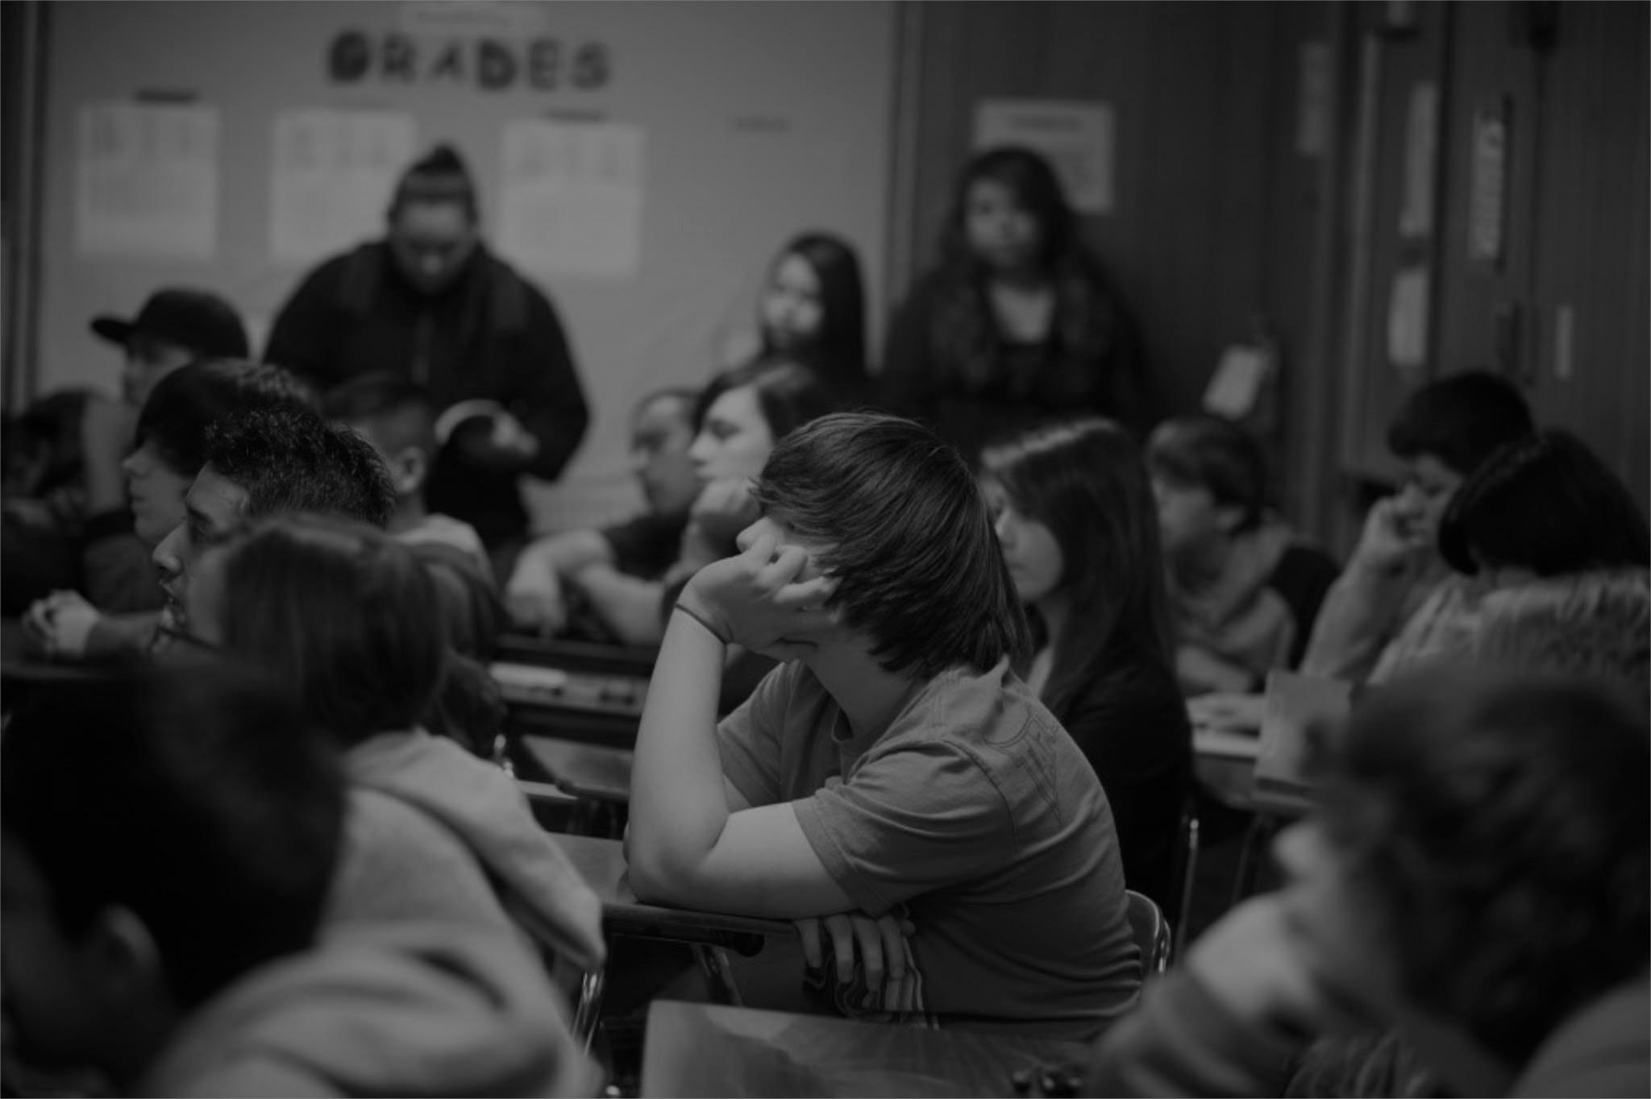
Most schools are not set up
to meet this challenge.
Teaching to the whole class means teaching to the lowest common denominator
Students are passive consumers of content
Lack of real world engagement limits excitement about learning
Notes:
“Traditional classroom teaching means teaching to the whole. We wouldn’t accept a group of us being treated the same in a medical office, why whould we accept it in a school except because we are used it. It isn’t necessary. We all remember being bored or behind or ahead of the class. Not necessary anymore.”
“Students are passive consumers of content, versus taking initiative. Not the kind of employees you want.”
“Lack of engagement and excitement, why does this even matter? Short attention spans, used to immediacy”
We need, you want different abilities which requires a different model.”
“The world is changing, fast. Schools are not.”

Slide 34
What if...
...we moved beyond book learning and the traditional classroom?
...we used a hands-on, project based approach?
...we created radically personalized learning experiences?
...we built character forged by field work and adventure?

Slide 35
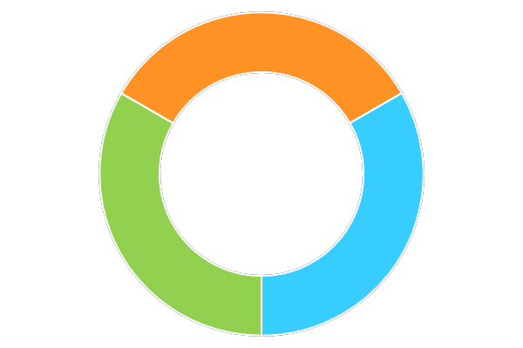
RADICAL PERSONALIZATION
EXPEDITION- BASED LEARNING
CONSTRUCTIVE
ADVERSITY
Notes:
Radical Personalization
Self-pacing and acceleration
Expedition-based Learning
Provides practical, real-world connections and applied meaning to the knowledge students learn in the classroom.
Powered by Constructive Adversity
Our unique educational approach that uses calculated risk-taking and authentic experiences to build adaptability, collaboration and resilience.

Slide 36
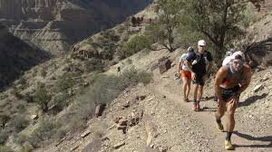
THIS IS HARD WORK
LESSONS LEARNED
x
Notes:
Discuss obstacles: cost, parents, students, teachers, politicians, districts, unions not to mention actual work creating something new with technical and culture challenges

Slide 37
SUMMIT LEARNING CASE STUDY
Positive
Free
Integrated Min. Viable Platform
Good training
Can spread innovations and quality materials widely
Challenges
Highly structured
Curriculum, assessment and projects are work in progress
LESSONS LEARNED
x
Notes:
Discuss obstacles: cost, parents, students, teachers, politicians, districts, unions not to mention actual work creating something new with technical and culture challenges

Slide 38
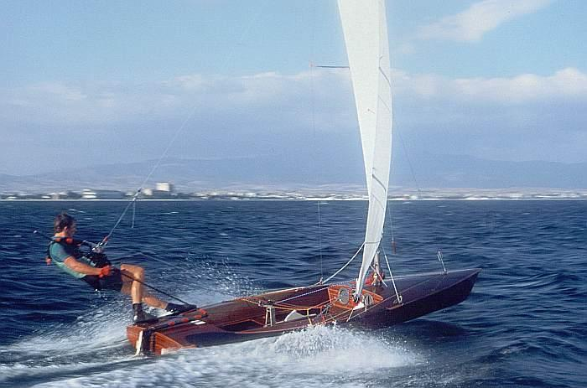
2. TRENDS SUPPORT
INNOVATION
High-speed internet access
MVP platforms, dashboards, curriculum
Budding proof points
LESSONS LEARNED
Factory model seen as not adequate
x

Slide 39
3. HOLE IN ECOSYSTEM
Schools need free, on-demand, valid and reliable assessments to implement quality competency-based education
LESSONS LEARNED
x

Slide 40
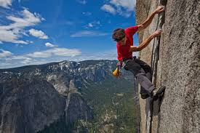
4. THIS MAY BE SCARY BUT TOGETHER WE CAN DO IT
LESSONS LEARNED
x
Notes:
Would you go to your doctor with 20 people?
You get 20 people treated with antibiotics even though you don’t need that?
Batch processing idiotic.
Schools of future:
Unbundled
No grade levels
No courses
No traditional classrooms
No
Mastery based, third party valid

Slide 41
Are you up for the challenge to LEAD the way?
Next Steps: Ask Questions - Connect with Us
Jeff Hinton visualizinghistory@gmail.com www.atech.org
http://thereformmindedteacher.blogspot.com/
Kimberly Regan kregan@snacs.org www.snacs.org
Mark Kushner markekushner@gmail.com
www.impactschools.com
Mary Alber mmeekalber@gmail.com www.eic-nv.org
Notes:
10 sec

Slide 42
APPENDIX - Supplemental Materials
RESOURCES
EIC Knowledge Hub for Personalized, Competency-based Education
XQ Foundation; XQ Super School Washoe Learning Lab proposal
Alliance for Excellent Education - Deeper Learning Network
Summit Learning - Personalized Learning Platform
Tipping point: Can Summit put personalized learning over the top? Chris Berdik, HechingerReport.org, Jan 17, 2017
Chan Zuckerberg Initiative (CZI): “Advancing human potential…”
iNACOL Webinars: How Teachers are Leading Change for Personalized Learning, Strategies for Leaders Shifting to Personalized Learning
FUTURE READY LEADERS assessment and training program, US Office of Education Technology

Slide 43
APPENDIX - Supplemental Materials
RESOURCES
A Transformational Vision for Education in the US (click links)
by Education Reimagined, an initiative of Convergence Center for Policy Resolution
EDUTOPIA - George Lucas Education Foundation; Information and Videos of deeper teacher and learning in action (Milton Chen)
P21 (Partnership for 21st Century Education) - early research and development of Rainbow model of 21C Skills and implementation process.
ISTE (International Society of Technology in Education) - Turn your classroom into a Personalized Learning Environment
Education Week: What is Personalized Learning?

Slide 44
Christensen Institute - PL Trends to Watch in 2017*
Pilot Network schools will have access to top research & expertise in Deeper Personalized Learning such as
1. How will 3rd party PL platforms play out?
2. ESSA assessment of “C&CR success”?
3. Wraparound services - role of states to boost?
4. Projects will proliferate - how & how fast?
*Julia Freeland Fisher, Education Innovation in 2017, 1.4.17
Michael Horn, Finding ‘Personalized Learning’ on the Gartner Hype Cycle, 1.8.17
Notes:
We’ll create a Knowledge Hub of updated resources on the best research and expertise on DPL to keep all Pilot Network members informed and engaged in national developments.
For example, the Christensen Institute has been a leader in analyzing and tracking developments in education disruption and innovation - and highlighted these four key trends for 2017.
------
Results coming in from traditional schools adopting cloud-based learning platforms from PL model schools (e.g., Summit Personalized Learning Platform, Matchbook School’s Spark, Brooklyn Lab’s Cortex, Alt School’s Alt School Open)....Will traditional schools succeed in using 3rd party platforms to individualize pathways and supports? Are professional development supports effective to scale personalized approaches across traditional settings?
How will states change and measure criteria for college and career readiness and “success” per ESSA? The past year saw states ramping up for a new reality under the Every Student Succeeds Act (ESSA), which places far greater leeway and oversight in state’s hands rather than residing with the feds. In 2017 states will get their ESSA plans off the ground and make important tactical decisions. States’ approaches to assessment will prove to be key harbingers of instructional changes to come. Watch for increased focus on performance assessment throughout K–12 and better proxies for postsecondary preparation and readiness at the high school level. The assessment instruments states ultimately choose will offer clues as to what emerging definitions of 21st-century “success” will look like; these decisions will also have major implications for content providers and publishers in the short term.
3. Wraparound services get a boost
Successful states will integrate academic and non-academic services
4. Projects will proliferate
3. Emphasis will be on critical thinking and collaboration

Slide 45
These shifts are essential - & SEISMIC!
“I’m 200% in favor of personalized learning,
...it’s no secret how to do it, and the materials are at hand.
But doing this right.... demands an education earthquake that will demolish almost every structure we’ve built over the past hundred years.”
CHESTER E. FINN, JR. Can Personalized Learning Prevail?
Flypaper Journal, Thomas B. Fordham Institute, July 26, 2017
Notes:
Chester FINN, from the Fordham Institute, observes wisely that realizing quality Personalized Learning is both essential and possible yet very challenging - as it represents a SEISMIC change from our current education system structures.
---------
“Personalizing our approach to K–12 education—and, while we’re at it, to pre-K and postsecondary education, as well—makes all the sense in the world. Hats off to Chan-Zuckerberg and others now striving (and investing) to make that real. But my goodness, how tall are the barriers that we’ve built and that they’re going to have to overcome if personalized learning is to prevail.”

Slide 46
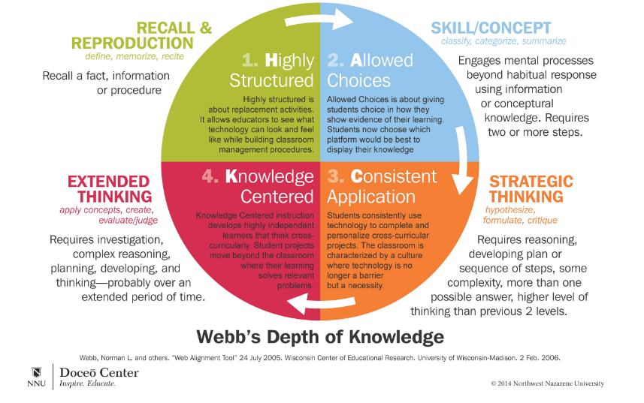
Need: Define DEPTH of 21C skills to be developed
Source: H.A.C.K. Model of Innovative Instruction, Northwest Nazarene University, Doceo Center
Notes:
This Webb’s Depth of Knowledge diagram helps us understand what DEEP thinking and application of knowledge means - which aligns with increasing learning independence.
STARTING in green quadrant upper left, Highly Structured work RECALL AND REPRODUCE FACTS, information, and procedures describes the bulk of what today’s curriculum and assessments address.
Moving across to the BLUE quadrant: Common Core Standards and ACT call for some skill with some conceptual processes - the ability to classify, categorize and summarize knowledge
Moving down to the ORANGE quadrant requires the capacity for strategic, critical, scientific thinking: hypothesize, formulate, evaluate more complex concepts across subjects - using technology
The lower left RED quadrant extends thinking to investigation, complex reasoning, planning, developing, and creating new knowledge through projects over an extended period of time - becoming a “highly independent learner”. The SELF-PRENEUR.
To be an active, contributing 21st century citizen and productive citizen in our complex world today requires higher orders of thinking, knowing, doing, and being than in the past.
We believe all students, regardless of initial job ambition, should graduate prepared to navigate their own lifelong learning journey through fulfilling occupations, personal life, and community engagement.

Slide 47
“Personalized Learning” is evolving...
Working Definition - 2014*
Education Week, October 20, 2014
Competency- Based Progression | Flexible Learning Environ- ments | Personal Learning Paths | Learner Profiles
In 2017, best practices include
More Competencies, more levels of mastery & rigor
More Student Agency: voice & choice in plans, actions
More Experiential, Applied Project-Based Learning
* Developed by the Bill & Melinda Gates Foundation, Afton Partners, the Eli and Edythe Broad Foundation, CEE Trust, the Christensen Institute for Disruptive Innovation, Charter School Growth Fund, EDUCAUSE, iNACOL, the Learning Accelerator, the Michael & Susan Dell Foundation, Silicon Schools, and educators.
Notes:
Initially, competency-based progression meant that students could complete the teacher’s existing assignments and tests at differing rates - now many more types of skills and competencies are being delineated with many levels of complexity that span classes and grade levels. The direction is toward seamless competency MAPS (knowledge trees) that integrate all subjects, skills, and levels - eliminating time and age-based credentialing.
Flexible Learning Environments - Originally referred to rotations through stations or rooms with blended and online learning options that included flipped classrooms of video instruction at home and homework in school. Now ‘FLEX’ can mean students have more autonomy in setting their schedule, choosing project topics and content learning resources from “playlists”, decide who they’ll work with, and how and when they’ll demonstrate competencies. This means much more adaptive staffing plans, space utilization and time allocation.
Personal Learning Paths originally indicated that students were all held to clear, high expectations, while each could follow a customized path to competency that adapted to his/her individual learning progress, motivations, and goals. Today we’re beginning to see this extended to differentiated graduation criteria aligned to college and career goals.
Learner Profiles initially captured each student’s record of their individual strengths, needs, motivations, and interests to help teachers differentiate, adapt, and tailor instruction methods to each. Today, comprehensive Personalized Learning Plans are co-designed by students with their teachers, parents, and counselors to include master LEVEL goals around detailed competencies that challenges them to achieve their STRETCH potential of each competency within a specified time frame; goals are neither too easy nor too hard for them to achieve and be successful.”

Slide 48
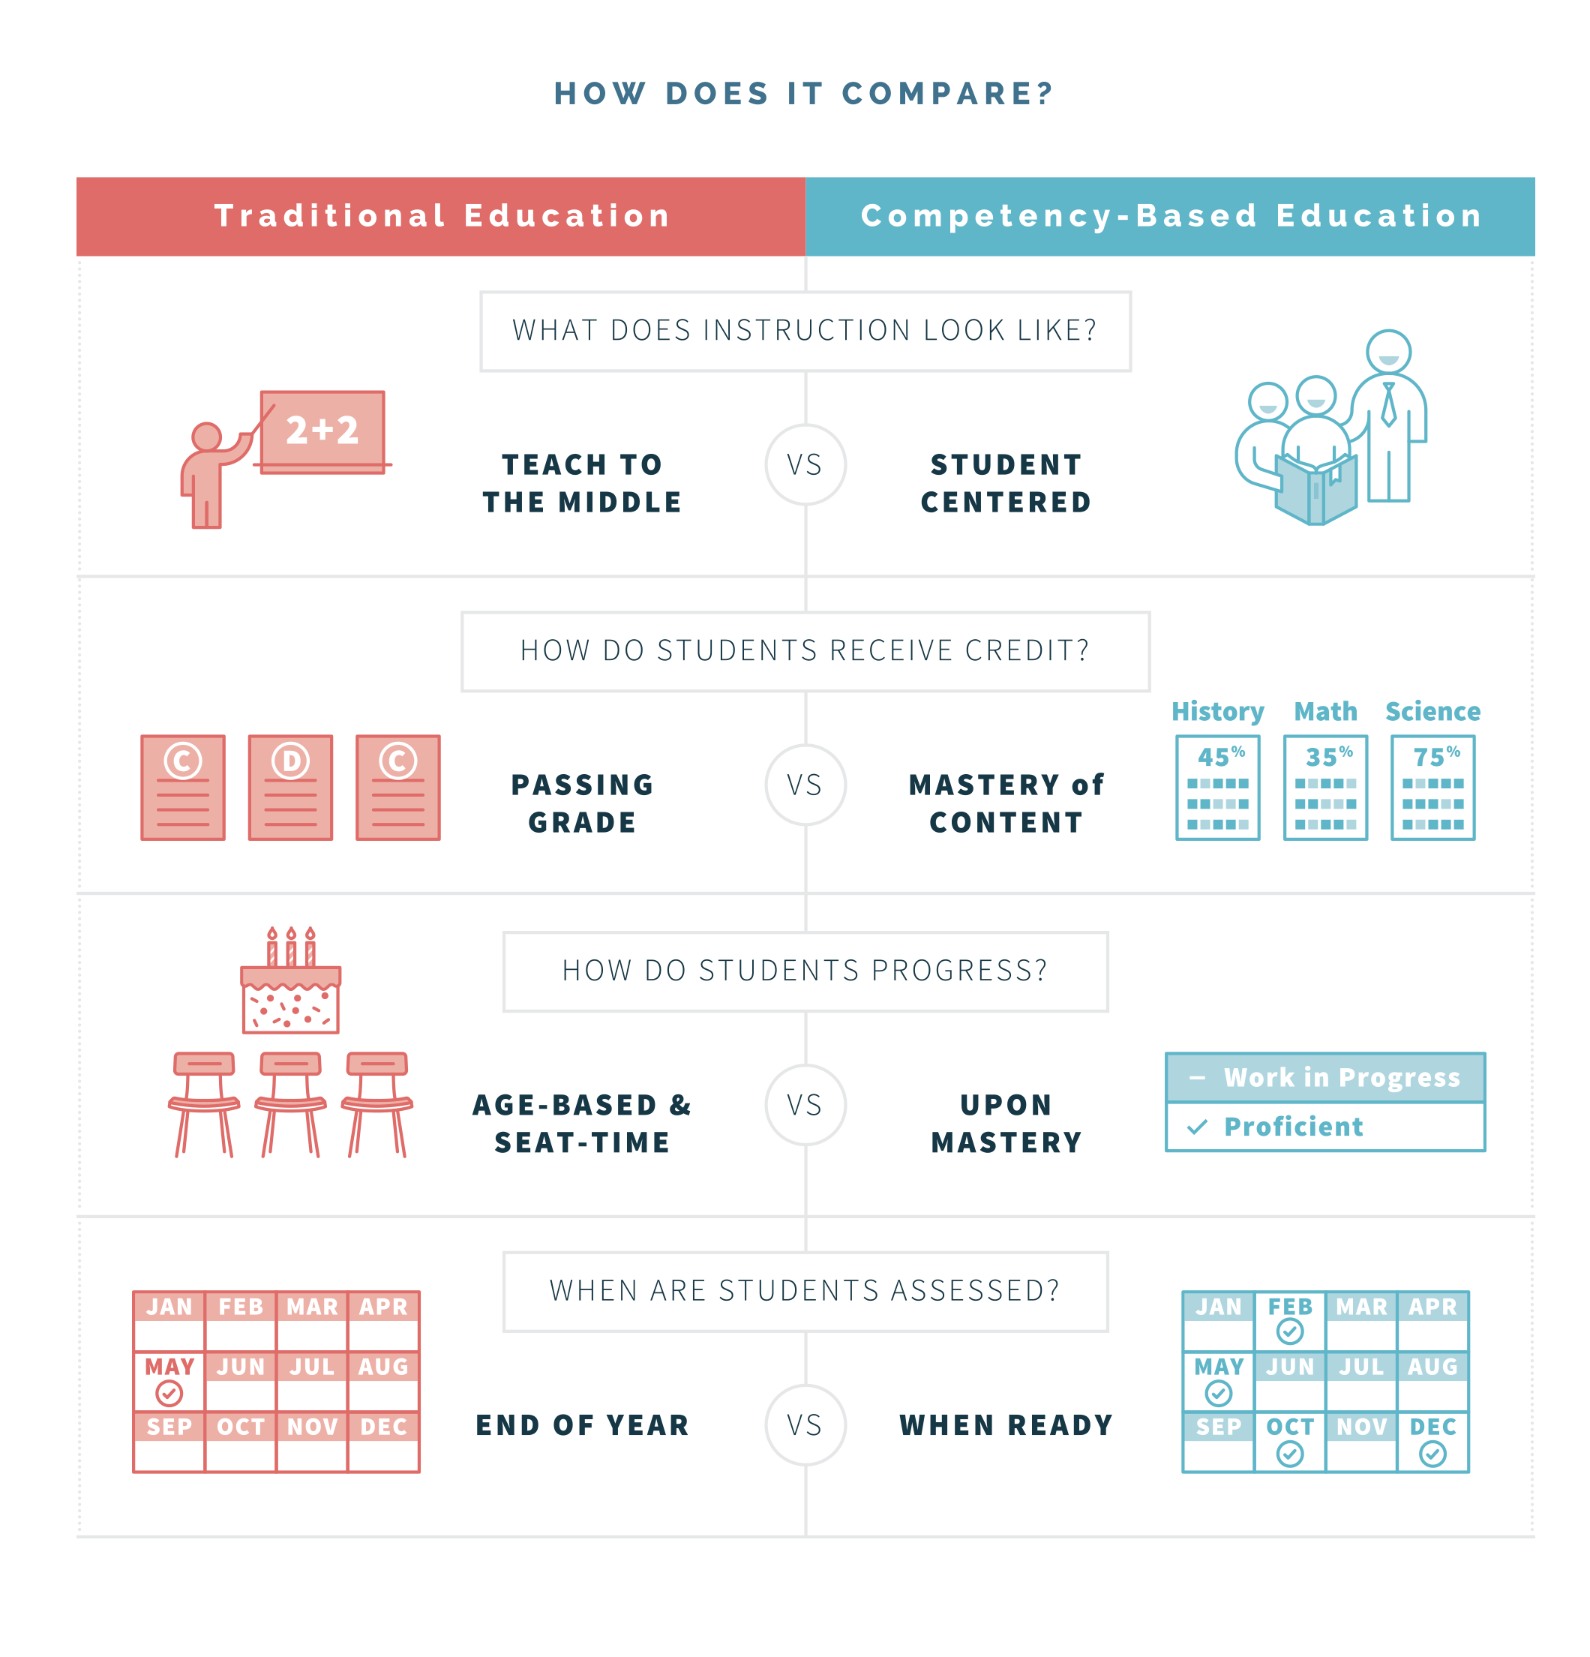
Why is PL so hard? Major structural changes
Source: ExcelinEd Resource Library website
Notes:
Invite to reflect where they on the spectrum of change

Slide 49
ADVICE from change program leads
Strong CHAMPIONS: Principal, VP, & lead teacher(s)
Strong CIT infrastructure & support; dedicated person for K-12 sites
Strong PD resources, process, platform, time; collaborative planning, real-time problem solving
Strong PARENT engagement; effective dialogue & participation process
Notes:
has vision and skills to manage change across the organization
arranges room, time, and PD credits (certifications for 21C learning)
changes title &/or compensate for teacher-leader innovators
advocates for support and policy change at district, state
informs parents and responds to concerns
can integrate programs K-12; esp. transitional grades (5th, 8th)
IT: device maintenance, wi-fi, application curating, security
learning coaches on-site
Application use approval process; ensure security, quality
Parents: frequent forums from beginning to inform and involve whole community in the planning, transition and ongoing student learning process

Slide 50
How to transform? Ed Reimagined initiative defined a learner-centered paradigm for our networked age;
A Transformational Vision for Education in the US (click links)
by Education Reimagined, an initiative of Convergence Center for Policy Resolution
Notes:
1 min What’s missing from the last two charts? Methodology - Instructional paradigm that meets the new CONNECTED World View
competency based, wide range of learning environments and adult roles. Contextualized, relevant learning ,
embedded in a network of supportive relationships

Slide 51
These practices call for TRANSFORMING the system; not just tweaking the current model.
TRANSFORM
21C Learner-Centered
IMPROVE current
NETWORK Model*
Funds follow student IEP & grad plan needs
Use competency-based progression to motivate growth & engagement
Use experiential PBL to increase student skills
Use ed tech to improve teaching quality, load
Develop career skills
Expand literacy skills (finance, IT, SEL, cultural)
Enable coach teams w/ teachers, counselors, parents, community mentors
FACTORY Model*
Funds to targeted programs (selective, isolated, overlapping)
Raise proficiency & grad rates w/ interventions (expensive), alternative pathways (less rigorous, reduced criteria)
Tie teacher comp to student performance on standard tests
Save $ by fewer teachers, larger class sizes
Use small pilots for NR21 (1:1 tech), CBE (unfunded)
*A Transformational Vision for Education in the US, Education Reimagined, an initiative of Convergence Center for Policy Resolution

Slide 52
How do we implement PL?
Foundational shifts require strong innovators willing to lead & model the change
Network Model
Features
Key System Changes
PERSONALIZED
COMPETENCY-based
EXPERIENTIAL inquiry
COMMUNITY-engaged
TECHNOLOGY-enabled
SCHEDULES differ BY STUDENT, Peer Group (not set by bells, teachers, courses, year)
PLPs for ALL (Personalized Learning Plan) w/ competency goals aligned to interests, needs, emerging college/career plans;
Flexible choice of tools, time, place, process, & people to learn & demonstrate mastery
Progress when achieve competency level
COMMUNITY-engaged PROJECTS; student-directed experiences involving real challenges with community members
24/7 ACCESS to technologies (6 - 12th) for blended learning, community-engagement, college courses, IT and career tech training, etc.

Slide 53
Summit Learning
Summit Overview Vimeo link
Personalized Learning Platform video - student's view and teacher's view
Tipping point: Can Summit put personalized learning over the top? by Chris Berdik, Hechingerreport.org Jan 17, 2017

Slide 54
Pilots will identify strengths and share what works best
strong
some
no/min
EXPERIENTIAL inquiry (PBL)
PERSONALIZED learning
COMPETENCY progression
COMMUNITY engagement
TECHNOLOGY- enabled
Charter School programs
NDE target population programs
Career Tech & College Prep programs
NR 21 pilots
CBE pilots
Notes:
We realize that the future of education involves incorporating these these five strategies which we call PCBEE : Personalized Competency-Based Experiential Education

Slide 55
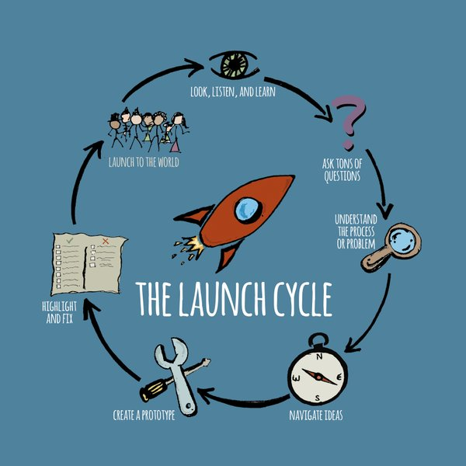
We’ll study what authentic inquiry-based learning looks like...
the “Driving Question” starts the Project-Based Learning (PBL) Launch Cycle;
Is our water safe to drink?
Why don’t I fall off my skateboard?
How can we improve traffic flow around our school?
How can we design a website to share information and opinions about novels that teenagers might like?
Source: Spencer, John; Juliani, A.J. (2016-05-26). LAUNCH: Using Design Thinking to Boost Creativity and Bring Out the Maker in Every Student
Notes:
1 min

Slide 56
To unleash each student’s unique creative potential, we’ll explore how to nurture individual self-awareness & efficacy
“The only true learning is self-learning” “To thine own self be true”
“Know Thyself”
Empower students to set their own learning goals, pace, place, & process based on personal capacity, needs, interests, goals, passion & motivation
PERSONALIZED
Pathway to graduation
Replace Time-based credit policies w/ Competency-based to empower personalization
COMPETENCY-Based
progression by demonstrated mastery
INQUIRIES (PPBL, Action Research)
Core LITERACIES

Slide 57
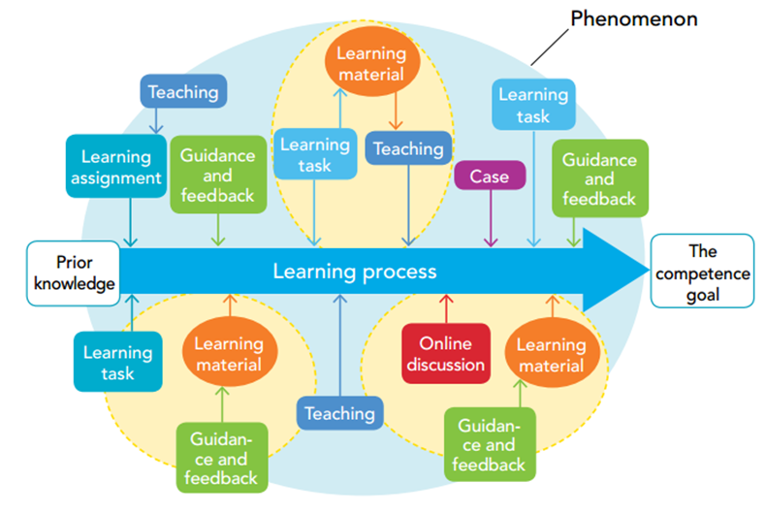
Next Steps:
DPL pilot participants will research best practices - such as Finland’s Phenomenon-based Learning that eliminates subjects
Notes:
We realize that the future of education involves incorporating these five strategies - summarized by PCBE (Personalized, Competency-based education) with IPBL (Inquiry Project-based Learning), CETE (Community-engaged, Technology-enabled) = SPLC Student-powered Learning Community

Slide 58
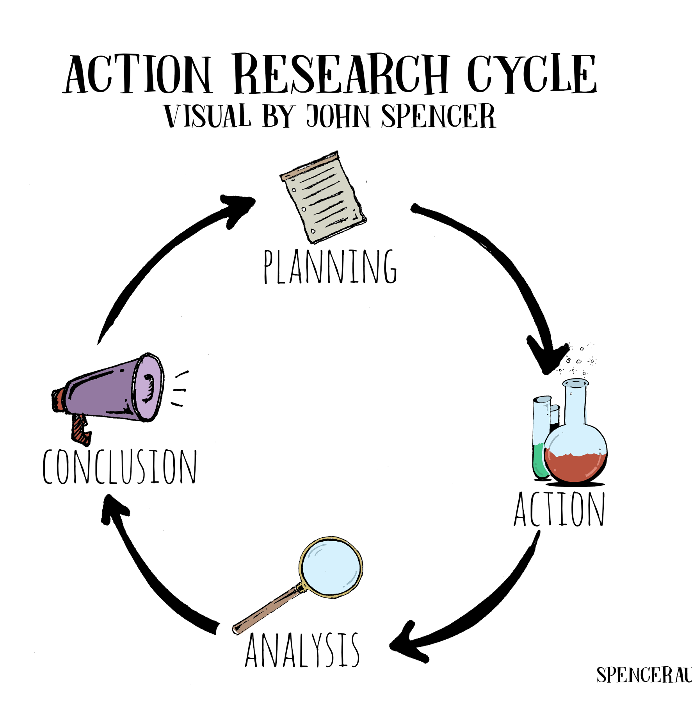
Lead educators will employ Action Research with each other & students to create highest quality learning experiences
Source: John Spencer, author of LAUNCH
Notes:
2.5 min video

Slide 59
DPL Pilots will explore the ultimate GOAL of education: to unleash the full potential of every student & teacher to be curious, self-driven, continuously creative CREATORS
Video by John Spencer, author of LAUNCH: Using Design Thinking to Boost Creativity and Bring Out the Maker in Every Student
Notes:
3 min

Slide 60
What is DEEP Personalized Learning?
Combining ALL strategies for highest learning quality
PERSONALIZED
differentiated instruction & pathways through content
driven by each student's
capacity, needs,
interests, talents,
passion, & mission
COMPETENCY-based
progression
students advance how and when they demonstrate mastery of 21C knowledge & skills to realize goals
EXPERIENTIAL inquiry
authentic, collaborative, investigation projects (PBL) into real-world phenomenon w/ peers, experts, & professionals
near & far
COMMUNITY engagement
Student Advocate Networks of parents, professionals, higher-ed
& community programs support & mentor expansive student learning opportunities
TECHNOLOGY-enabled learning
state-of-art tools for communicating, learning, creating, assessing, coaching, doing projects, & developing 21st century professional skills for high quality college, career, & citizenship
Notes:
The future of education will likely incorporate all five strategies - which EIC calls PCBETL : Personalized Competency-Based Experiential Technology-enabled Learning

Slide 61
We’ll study programs that optimize student engagement & outcomes by offering both robust experiential inquiry AND student autonomy.
100% Skill
Active
experiences
real, applied, demonstrations
NV District School
Innovations HS
(Big Picture)
+IMPACT
schools
P-12 (CA)
NR21 pilot
A-TECH
Magnet CCSD
High Tech High
Personal CBE pilot
SNACS
Sierra NV Charter P-8
SUMMIT Learning
w/ Personalized Learning Plans & Projects (4-12)
Extent of SKILL
vs. CONTENT focused learning
AACT
Magnet WCSD
New Tech Network
TMCC
LEAP program
Charter w/ building
Carson City SD 3-12th
Incline HS AP w/
1:1
Charter virtual
UNR
Dual Credit
CCSD Summit CBE pilots (4-8)
Galena AP Courses
not 1:1
Northstar
WCSD Blended
Private w/ Personal Expeditionary
100% Content
Passive instruct,
test writing
BYU
credit recovery courses
K12 &
Connections
Academy
Higher Ed
100% Teacher/ Course plan
fixed progress
100% Student/ Group plan
flex progress
Extent of TEACHER
vs. STUDENT direction

Slide 62
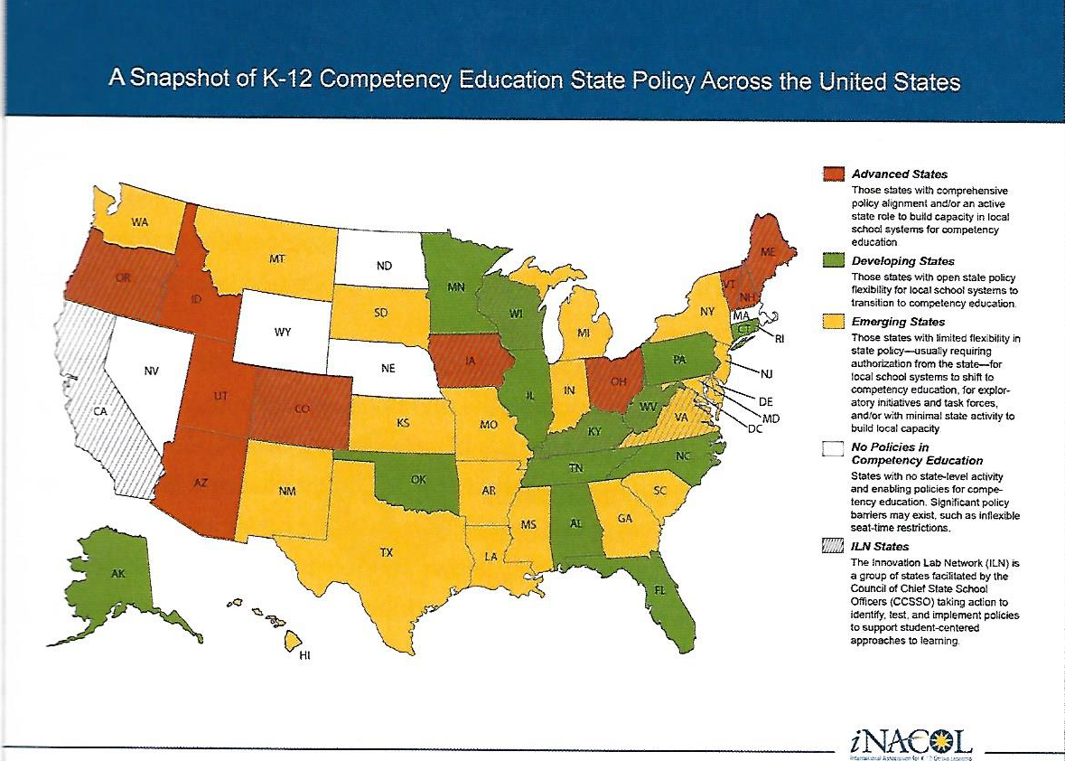
Competency-based Education is rapidly spreading in the US
NV passed A.B. 110 - to create a CBE Pilot Network

Slide 63
CBE program seeks Pilot Network school - interested?
Competency-based education (CBE) per AB110:
“A pupil is granted credit for a course of study when the pupil demonstrates proficiency to meet the objectives of the course or the objectives of a particular area or areas of the course”
District and charter schools can apply for grants to participate in Network:
Establishing school sites at which CBE can be observed
Investigating, developing, & implementing CBE pathways for pupils
Developing performance measures [for] pupils to demonstrate proficiency to meet objectives of a course...and receive credit w/out attending regularly scheduled classes
Developing/acquiring examinations/assessments to demo proficiency
Supporting the transition of schools to CBE
Identifying & purchasing technical assistance & PD materials
Documenting & sharing results, challenges, lessons learning relating to implementation of programs for CBE
Source: AB110 and NDE

Slide 64
Benefits of student-driven project-based learning:
Students’ motivation & achievement are higher when they explore their own lives, communities, & personal curiosities.
Question & project designs integrate academic standards to be learned and demonstrated across subjects;
builds competency with cross-disciplinary thinking
project “artifacts” presented to an audience for feedback
Teams of students are guided by teachers to develop their skills of collaboration, communication, creative & critical thinking
Each student has individual responsibilities and is assessed on both team & individual performance, by teachers, students, self
Reflection time is built in to deepen learning:
“What are we doing well? What can we do better? What do we want to investigate next?”
Notes:
2 min

Slide 65
Competency-based policies CAN empower deep student learning in many ways - if implemented well;
Students use Personalized Learning Platform (PLP) for
Universal IEPs; different learning plans meet unique needs and goals (homeless at-risk youth, special needs, gifted & talented students, career or college bound)
More comprehensive & deep 21C skills are expected, developed, & assessed to meet desired career path needs
Inquiry Projects to build & demonstrate broad, higher order 21C skills & knowledge (minimal use of online passive courses)
Teachers spend high quality 1:1 time w/ every student
Real-time needs identified & addressed - daily, formative
More independent student work; reduces class & group sizes
More time to collaborate to develop skills and relationships
Higher job satisfaction

